Slide 1
Ethics in Modern Data Bias, transparency, and impact
William Assaf and Christine Assaf

Slide 2
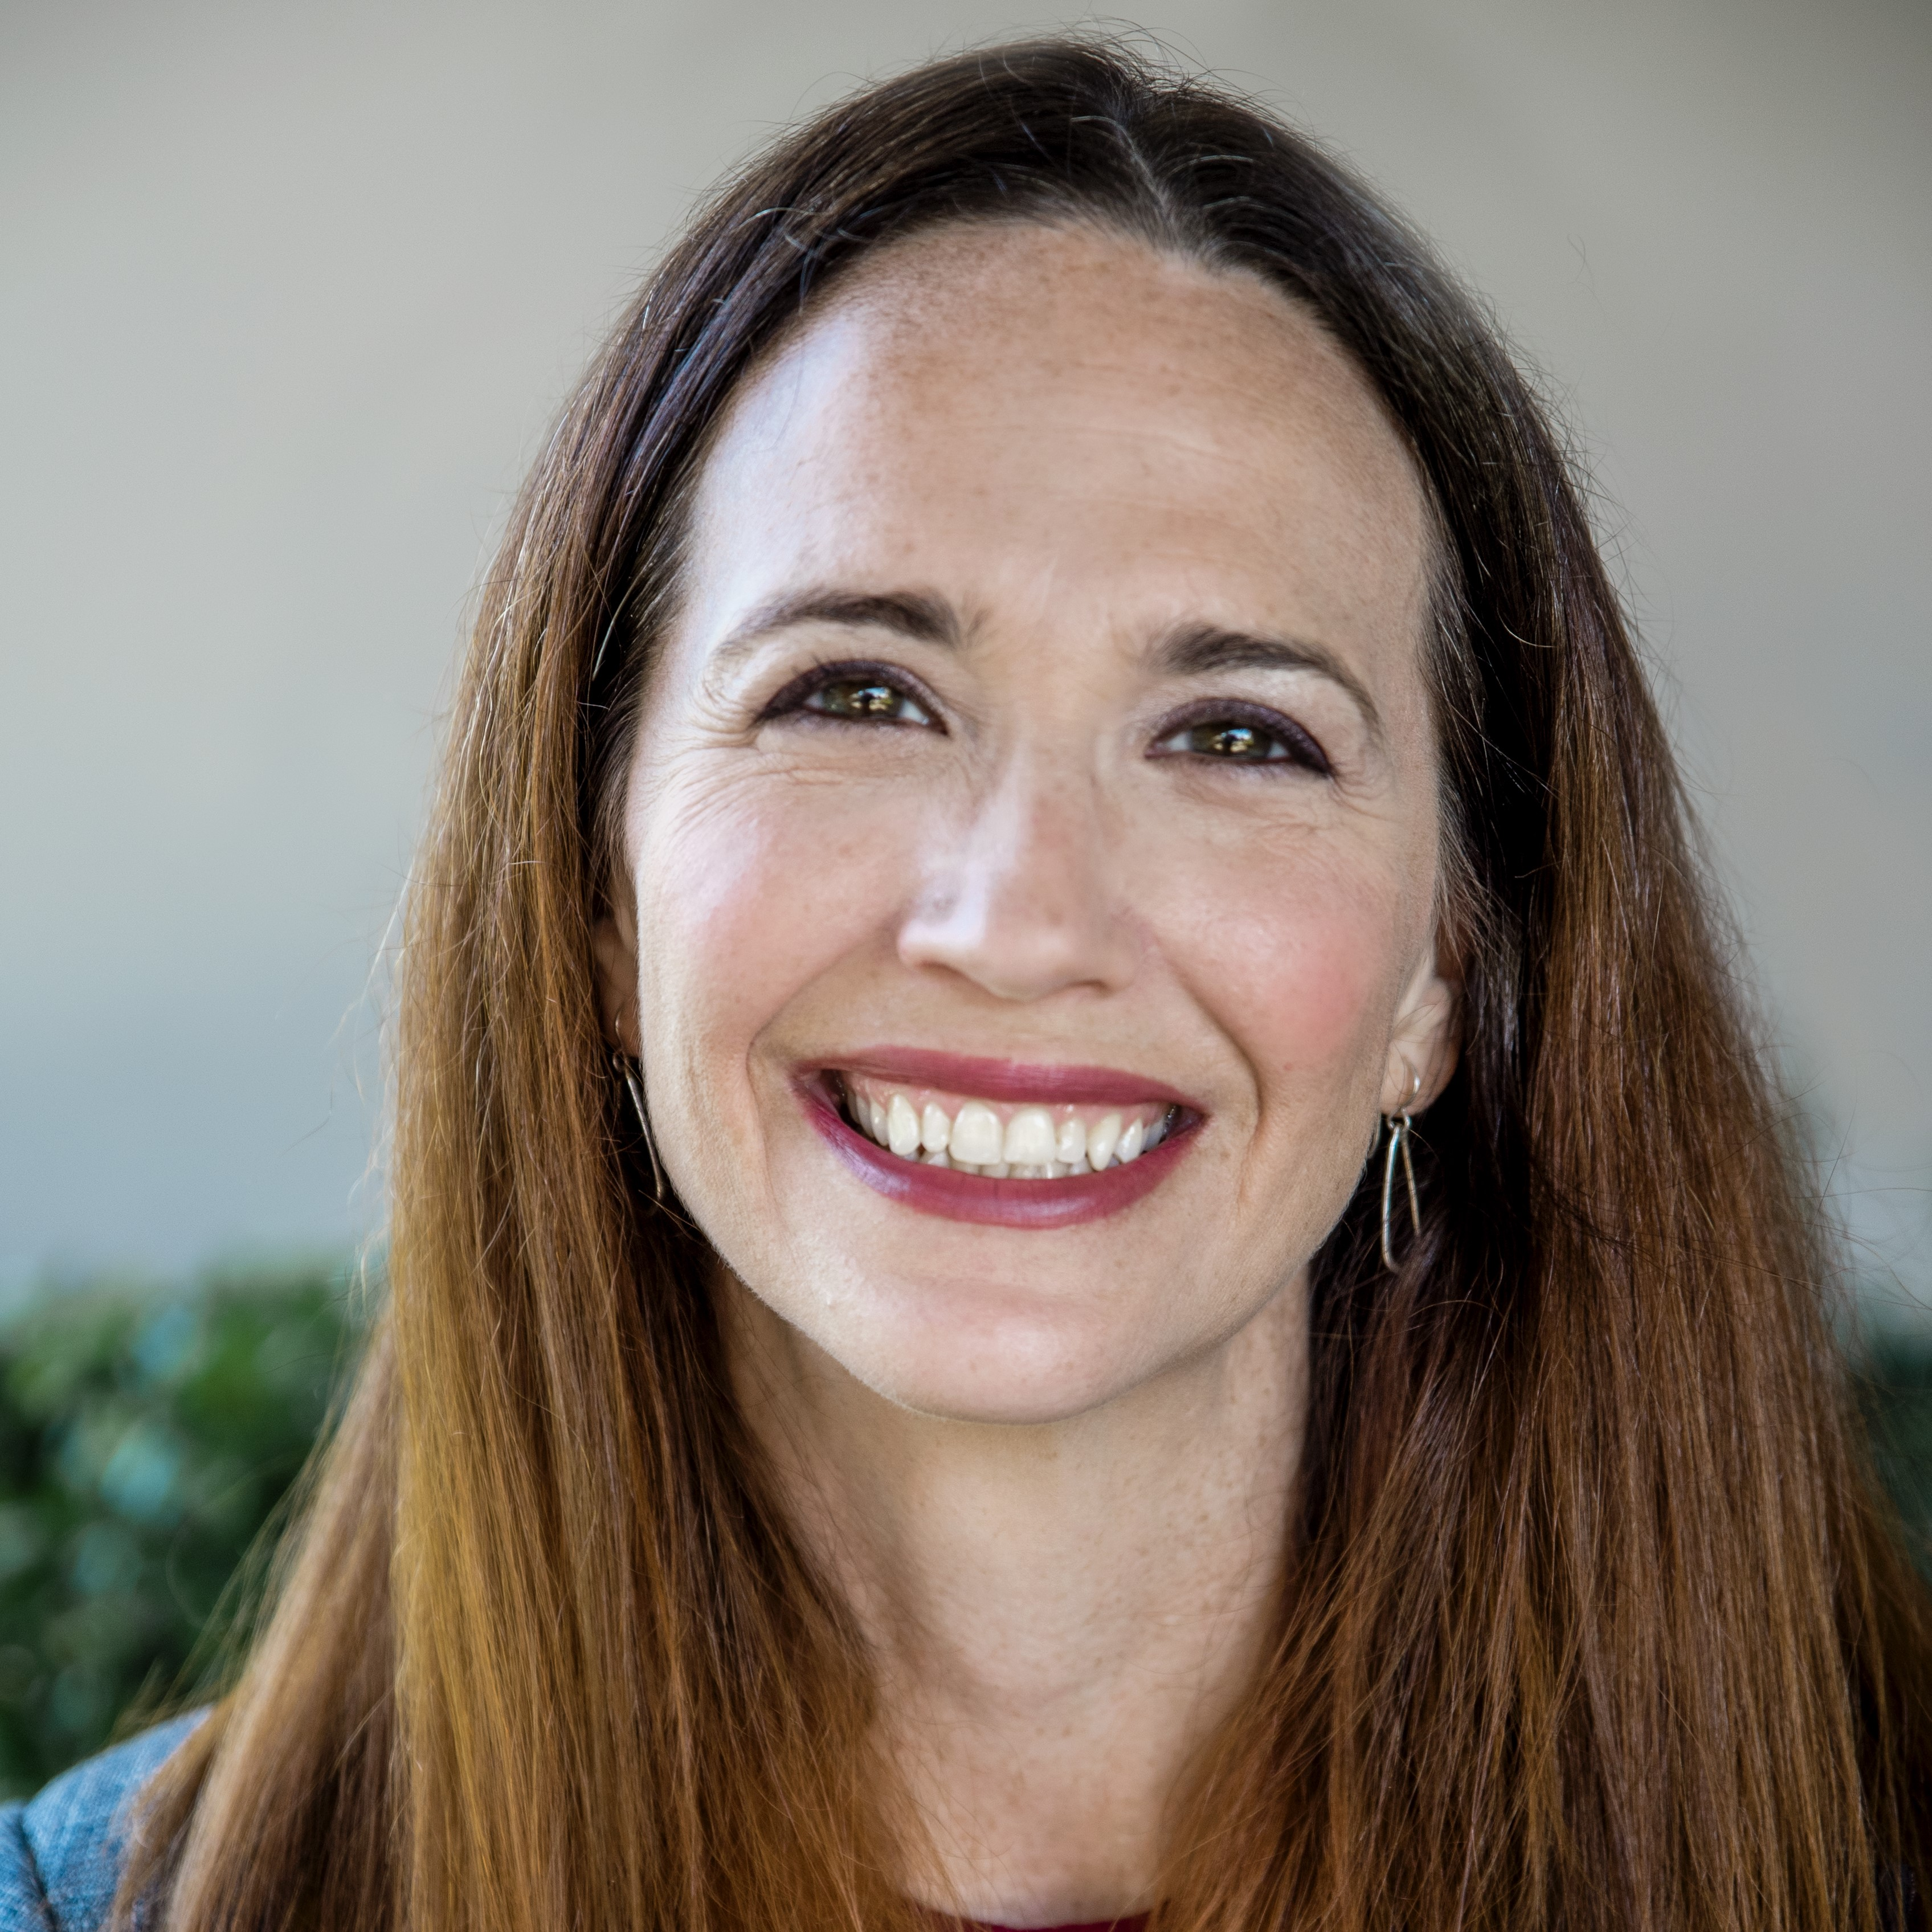


Christine
Assaf
She/Her
Sr. HR Consultant
Masters in I/O Psychology
Consultant in Leadership and Organizational Development
15+ years business and HR experience
Focus on People Strategies, Training & Development
Archbright
@hrtact
hrtact.com
linkedin.com/in/christineassaf

Slide 3

William
Assaf
He/Him
Sr Content Developer
Microsoft Data Platform SME. Former Data Platform MVP, 18 years as SQL developer, consultant, DBA, manager.
SQL Docs lead for Synapse SQL, Azure SQL DB, SQL performance, PolyBase, others
Lead of author team for Microsoft Press SQL Inside Out series in 2017, 2019, 2022 (soon)
Speaker, former SQLSat organizer, STEM volunteer and trainer
Microsoft
@william_A_dba
sqltact.com
linkedin.com/in/williamdassaf

Slide 4

Christine Assaf (she/her)
Human Resources
Leadership Development, Organizational Development, People Strategies, Training & Development
Masters, I/O Psychology
The study of behavior of individuals and groups in the workplace to determine how to improve performance and productivity
HR Consultant
HRTact.com
/christineassaf
Speaker/Trainer/Writer
@hrtact
Communication, Management, Leadership, Team Building, and more

Slide 5
William Assaf (he/him)
Microsoft Data Platform expert
Author of SQL Server certification exams, Previously Principal Consultant, DBA Manager, Microsoft Data Platform MVP
Author, SQL Server Inside Out
Lead of author team for Microsoft Press SQL Inside Out series of books since 2017.
Senior Content Developer, Database Docs, Microsoft
Speaker, STEM Volunteer
SQLTact.com
Past organizer of SQL Saturday Baton Rouge, Baton Rouge SQL Server User Group, former PASS Regional Mentor
/williamdassaf
@william_a_dba
Notes:
After many years as a SQL Server consultant including as a Microsoft MVP, I joined the Microsoft Database Docs team a couple years ago.
Worth noting that while we have citations throughout our presentation, any opinions are our own alone.

Slide 6
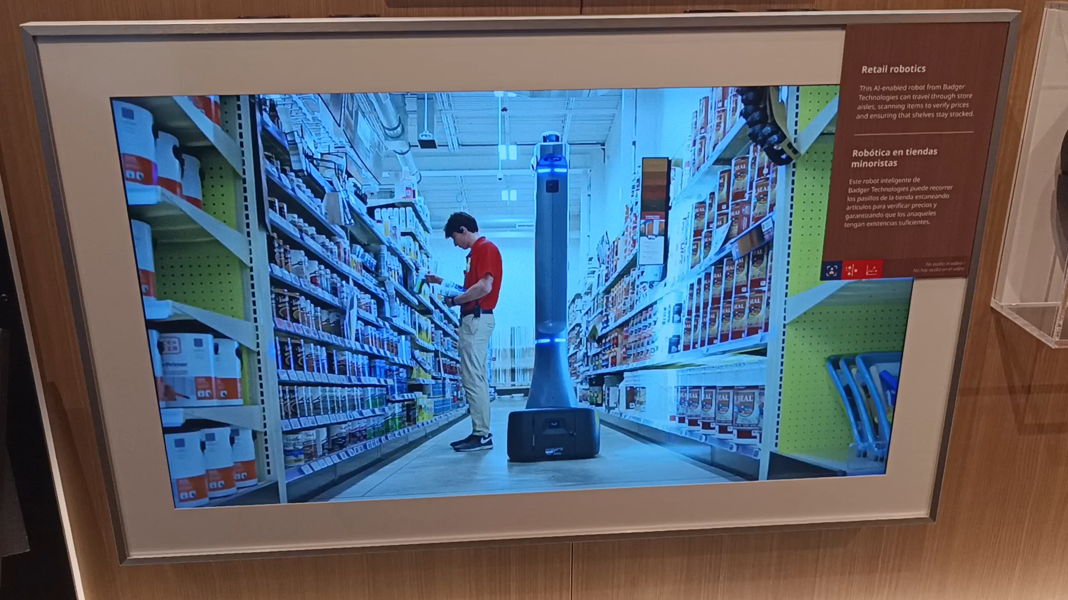
Boston Museum of Science 1
Notes:
William
So we were recently in Boston and got to visit the world class Boston Museum of Science. And they have a new wing all about artificial intelligence and machine learning, lots of interactive displays.

Slide 7
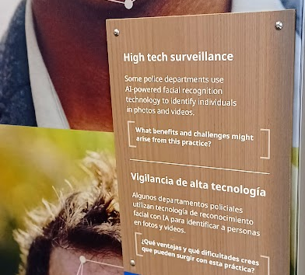
Boston Museum of Science 2
Notes:
William

Slide 8
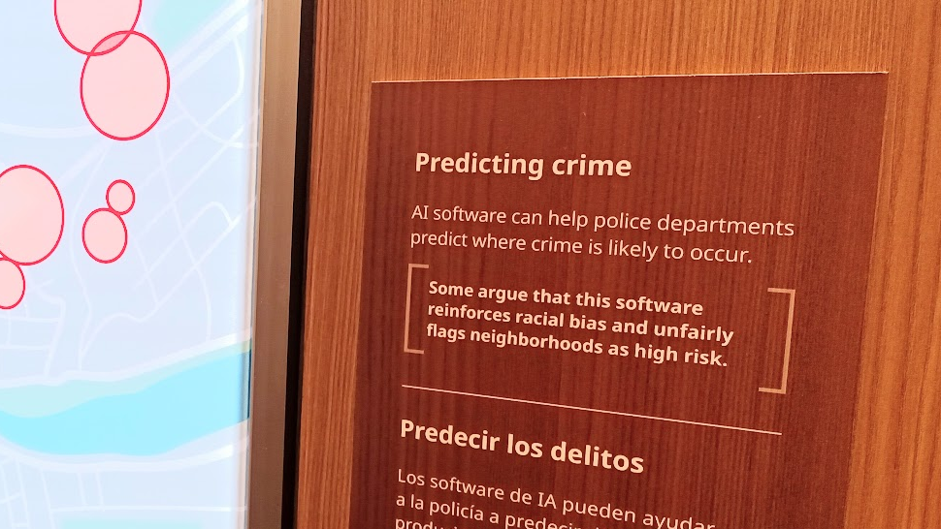
Boston Museum of Science 3
Notes:
William

Slide 9
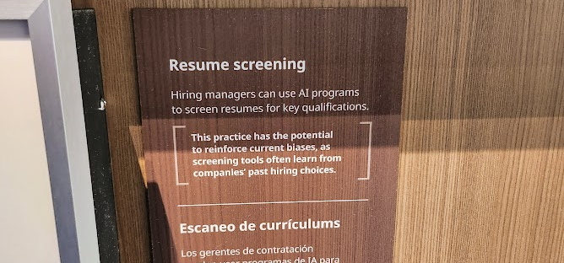
Boston Museum of Science 4
Notes:
William

Slide 10
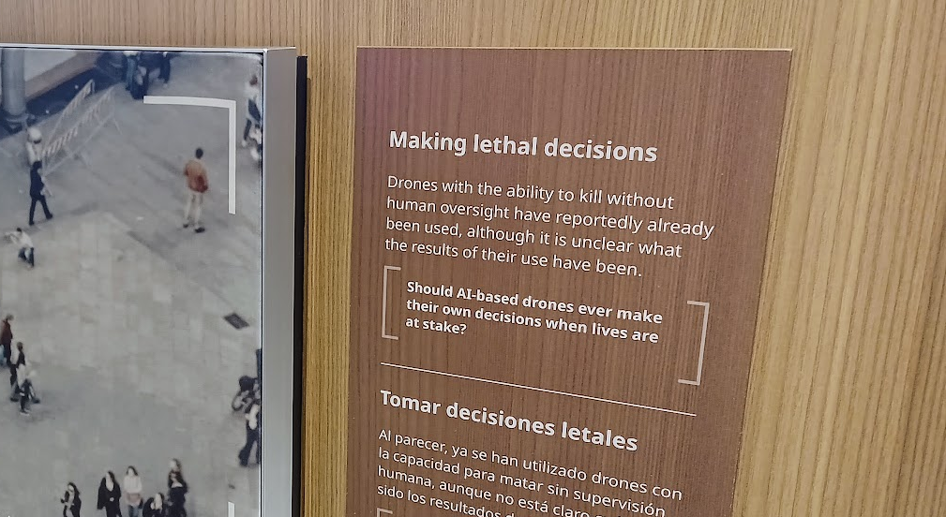
Boston Museum of Science 5
Notes:
William
What questions about bias, about transparency, about data collection and the use of that data, did these pictures raise for you?
Today we are going to be talking about bias in data analytics and data collection,
what we can to do recognize our own bias and fight the perception of bias,
and on how bias in data has real impacts in our society.

Slide 11
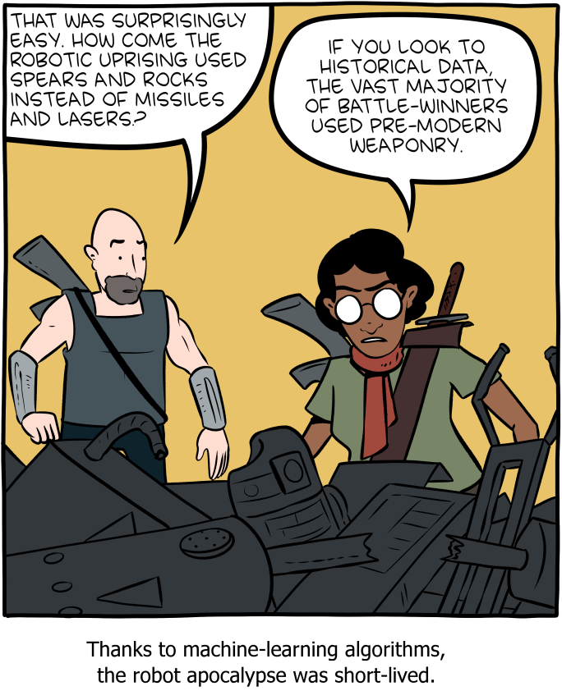
Historical Bias
Image: https://www.smbc-comics.com/comic/rise-of-the-machines
Notes:
WILLIAM
But without context, without understanding historical or time-based biases, both we and our data findings are doomed to parrot bias.
We understand this potentially an international audience, so one thing to keep in mind is that we are from the United States, and many - but not all - of our examples are based on United States history. We will try to be as expository as possible when setting the context here, but if you have any questions, we are open to requests for clarification or questions at the end of the presentation. We have time for that.
We also will make these slides available, and you’ll find references to our sources at the bottoms of each slide, as well as resources to read and learn more at the end.
And this is one of my favorite web comic series, Saturday Morning Breakfast Cereal, with a take on why the robot uprising used spears and rocks, and example of historical, time-based, bias.

Slide 12
Bias
Notes:
C
If trained on data which contains human bias, then of course our data outcomes will learn bias.
Worse, they are likely to amplify it, institutionalize it, and mask it in the trustworthiness of an “algorithm.”

Slide 13
Bias
“Bias is an inaccuracy which is systematically incorrect in the same direction.
Many algorithms which are trained to do a human job will have been trained on human generated data … This is a huge problem, especially if people assume that algorithms are impartial and can’t hold the same biases as people do.”¹ - Laura Douglas
¹ https://medium.com/@laurahelendouglas/ai-is-not-just-learning-our-biases-it-is-amplifying-them-4d0dee75931d
Notes:
C
Laura Douglas an AI researcher defines bias as an inaccuracy which is systematically incorrect in the same direction. Many algorithms which are trained to do a human job will have been trained on human generated data … This is a huge problem, especially if people assume that algorithms are impartial and can’t hold the same biases as people do.
This presentation is about acknowledging both the public’s perception of the trustworthiness of statistical analysis, and also our responsibilities as data professionals, developers, analysts.
This presentation is about our ethical responsibilities as data professionals to become aware of bias, acknowledge it, and be accountable for it.

Slide 14
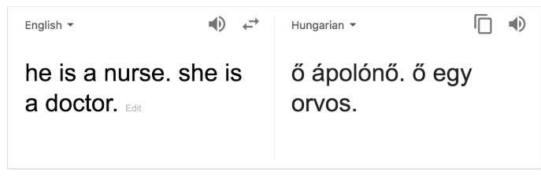
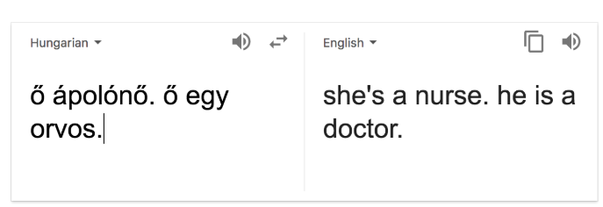
Bias
https://medium.com/@laurahelendouglas/ai-is-not-just-learning-our-biases-it-is-amplifying-them-4d0dee75931d
Notes:
C
Here’s an example of bias… This is from Google Translate.
See here he is a nurse, she is a doctor,
<animation>
but if you reverse the translation, the gendered language is reversed, and gender norms are enforced.
<animation>
Biases are “live on display” in the wild. Try it yourself with a number of languages, this works for Hungarian and Turkish to English.
This is only helping to further society’s implicit biases, in this case, on gender norms in professions. Now, this isn’t just limited to a translation picking one gender as default… <next slide>

Slide 15
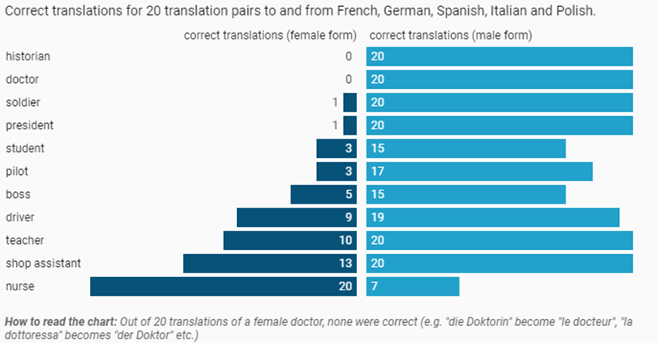
Gender Bias in Translation
Source: AlgorithmWatch Get the data
Notes:
C
…In translations to and from many European languages, the concept of a female doctor or historian is unknown to Google Translate.
Out of 20 translations of a female doctor, none were correct.
And out of 20 references to a male nurse, only 7 were correctly translated.

Slide 16
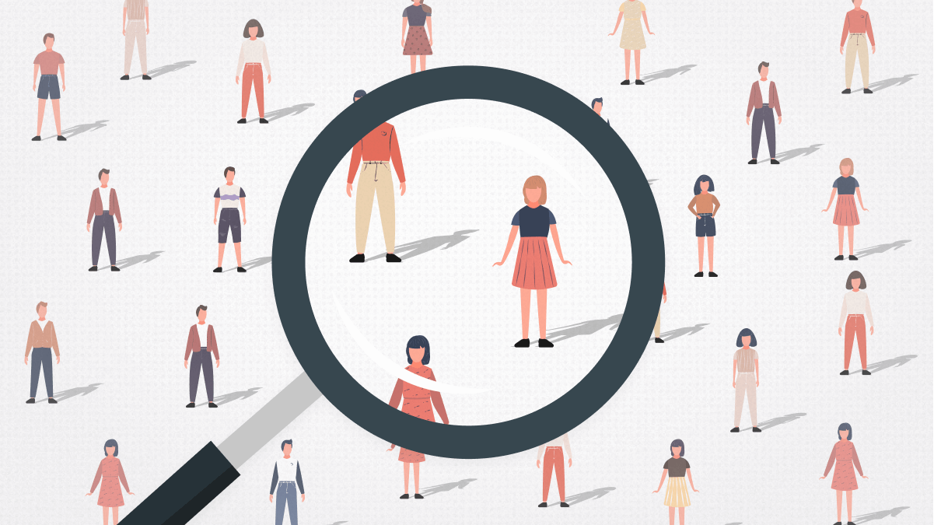
Notes:
C Without examining your data for bias, and developing awareness of historical bias in source data, you will present unethical findings - at best.
Bias exists. It must be identified and acknowledged.
Conclusions drawn based on biased data, without caveats, statistical controls, and historical context, may be highly unethical.
Let’s look at some more examples of that…

Slide 17
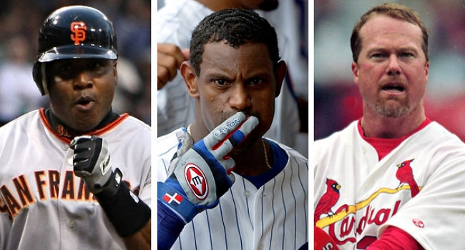
Bias in MLB’s Steroid Era
“A significant increase in players who hit more than 40 HR in a single season during the steroid era.” ^{1,2}
¹ https://bleacherreport.com/articles/480826-the-steroid-eras-destruction-of-major-league-baseball
² https://www.omicsonline.org/open-access/the-effect-of-the-steroid-era-on-major-league-baseball-hitters-did-it-enhance-hitting-2161-0673-1000161.php?aid=53354
³ http://www.espn.com/mlb/topics/_/page/the-steroids-era ⁴https://www.baseball-reference.com/leaders/HR_season.shtml Image: http://baseballhotcorner.com/the-official-all-time-ped-all-star-team/
Notes:
WILLIAM
<read notes>
This discusses Major League Baseball. Widespread use of steroids in the late 1990’s and early 2000’s set many new home run records.
The data shows there was a significant increase in players who hit more than 40 HR in a single season during the steroid era.”
“Though steroids have been banned in MLB since 1991, the league did not implement leaguewide PED testing until 2003.”³
The top 6 HR single seasons in history were all between 1998-2001, all by these three men pictured here, Barry Bonds, Sammy Sosa, and Mark McGwire.⁴ If you’re curious and a baseball fan, this past season (2022) Aaron Judge hit 62 home runs, good for only 7th best, though it is now considered to be the non-steroid era single-season home run record.
This knowledge of their illegal actions in the steroid era, affects our historical data analysis of:
training techniques,
scouting,
coaching,
Hall of Fame eligibility,
long-term player health,
player compensation,
Even ballpark batting statistics. Any ethical analysis that you’ve read in sports reporting or statistics accounts for this, you’ve probably seen such caveats when reading about these home run records.
When presenting analysis of baseball data, whether you’re a sports fan or not, of course we would discuss the steroid era behavior. Even casual observers would ask, “well, what about the era of baseball where steroids were unmonitored?”
Easy enough to understand, I think. Even if you’re not a sports fan, it makes sense to at least discuss and acknowledge the steroid era in any responsible analysis. Imagine a machine learning system trained to make recommendations on player training or prospect scouting. We wouldn’t want our ML model making recommendations that our prospects start using steroids, that’s silly, but of course, entirely possible.
OK, that was a soft ball, let’s dive into a more difficult subjects.

Slide 18
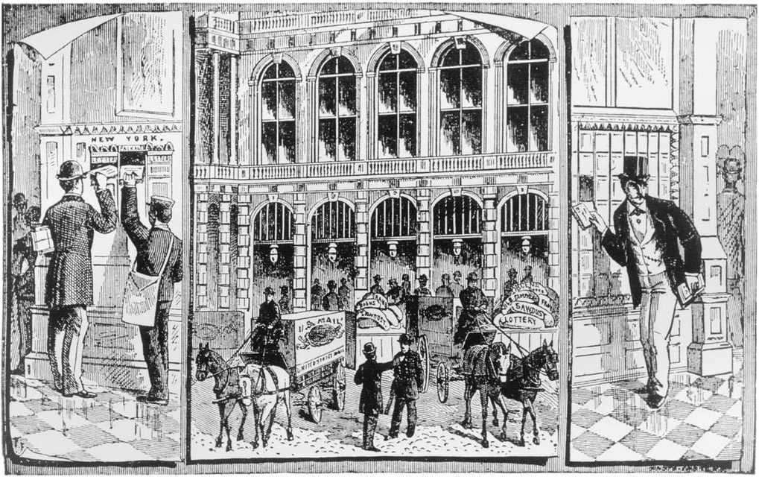
Bias in Censorship
U.S. Comstock Laws
Book censorship
Media self-regulation.
¹ https://lithub.com/the-history-and-present-of-banning-books-in-america/ ² https://www.washingtonpost.com/education/2022/02/10/book-bans-maus-bluest-eye/ ³ https://journals.sagepub.com/doi/pdf/10.1080/03064228808534489 ⁴ https://scholarship.law.wm.edu/cgi/viewcontent.cgi?article=1897&context=wmlr ⁴ Tebbel, John William. 1975. “A Brief History of American Bookselling.” Image: http://people.loyno.edu/~kchopin/new/related/comstock.html
Notes:
WILLIAM
In the United States, the Comstock Laws in effect from 1873-1957 had a widespread and lasting cultural impact, banning “obscene, lewd, or lascivious” materials.
“Attacking books has been an American tradition since 1650”, with documented cases going back to the Puritans of the Massachusetts Bay Colony. “Charles Darwin’s “On the Origin of Species,” probably the most influential book ever banned, was censored in 1895 for violating Christian beliefs.”²
At various periods of the 20th century, and currently, libraries have experienced “cultural censorship of: racism, sexism, nudity, religion, and evolution.”² In fact the American Library Association in 1984 “discerned a 'continuing pattern' of suppression of information” from the government.² For example, the 1980s ushered in a new push to libraries, school boards, and government agencies to censor books.¹ Recently, a renewed wave of cultural censorship has attacked libraries on topics of gender, sexuality, history, and racism.
And the “media almost invariably yield to pressure… and establish some sort of code of self-regulation.”⁴ and a sense of self-preservation.
This knowledge affects our analysis of book publication/sales, readership, popularity, public sentiment and sociological trends, even trademark conversations must be aware of “censorship placed on the industry from religious groups, patriots, unions, private businesses…”⁴, and of course the government. Just because publications weren’t sold or available, doesn’t mean the publications didn’t exist, or that there wasn’t public interest in them. Banning books from libraries and schools can’t prevent children from finding them,² so this continuously complicates historical data on book sales and the types of books being written, as cultural censorship has both a notoriety boost and a chilling effect on books and libraries.
By the way, the Comstock laws also prohibited the mailing and sale of contraceptives, and it was not until 1972 that the United States Supreme Court legalized birth control for all citizens, irrespective of marital status.
This knowledge affects our historical data sources on all sorts of data on:
American birth rates,
reproductive health history,
family planning choices,
family size preference,
foreign aid,
and public health policy.

Slide 19
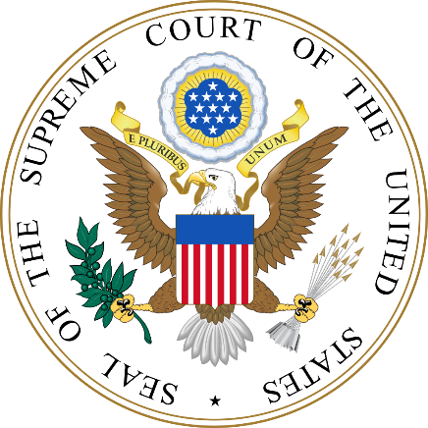
Bias in Judicial Sentencing
“Ethnic and gender biases in sentencing where judges have discretion, but no biases where discretion is limited.”¹
Studies have found disparate racial outcomes in sentencing discretion and “in almost every stage of prosecutorial discretion.”^{3,4,5}
¹ https://onlinelibrary.wiley.com/doi/pdf/10.1002/bsl.2370100205 ² https://www.aclu.org/sites/default/files/assets/141027_iachr_racial_disparities_aclu_submission_0.pdf
³ https://www.ussc.gov/sites/default/files/pdf/research-and-publications/research-publications/2017/20171114_Demographics.pdf ⁴ https://orgs.law.harvard.edu/acs/2016/02/08/racial-bias-and-prosecutorial-discretion/#_ftn2 ⁵ https://repository.law.umich.edu/cgi/viewcontent.cgi?referer=&httpsredir=1&article=2413&context=articles ⁶ https://www.fd.org/sites/default/files/criminal_defense_topics/essential_topics/sentencing_resources/fact_sheet_-_ussc_report_on_racial_disparity_is_flawed_and_being_misused_-_january_2018_-_final.pdf Image: public domain
Notes:
WILLIAM
<read notes>
There is significant, historical and modern day evidence for race-based bias in federal judicial sentencing.
A 1992 review revealed “both ethnic and gender biases in sentencing where judges have discretion, but no biases where discretion is limited.”¹
Another study in 2014 found that sentences for Black males in the U.S. federal justice system are nearly 20 percent longer than those for white males convicted of similar crimes.²
<click>
This data is complicated because objective data does not include the intentions of judges and prosecutors. The objective data only includes the outcomes. But by examining where discretion was and was not limited, and by comparing objective data on convictions, the data speaks to two different potential causes.
First, two Supreme Court cases United States v Booker in 2005 and Gall v United States in 2007 gave federal judges more discretion on sentencing.
And second, studies found bias in prosecutorial discretion, that is, in decisions on who to charge, and with what severity of charges.
Bias in both sentencing discretion by judges and prosecutorial discretion by attorneys general contribute to outcomes resulting in racial disparities in the U.S. criminal justice system.
Perhaps accounting a judge’s discretion, “Charges with mandatory minimums are disproportionately charged against Black defendants.”⁶
Analysis of severity and length of sentencing, acquittals, prosecutorial effectiveness, evidence collection, interrogation techniques, prison population, recidivism, probation, rights for felons, all must take into account biased outcomes on race. Flawed data on racially biased judicial proceedings can only will be used to draw frankly racist conclusions. This is the classic problem of garbage in, garbage out in any data analysis.
Analysis without this historical context would only reinforce and institutionalize historical racial bias. Drawing conclusions from this data without context of legal racial segregation and discrimination in the United States in the 20th century would be highly unethical.
So we’ve talked about some pretty cut and try examples of historical bias. This is a preview of how we’ll talk more about of bias in history and current events. We need to be aware of this, so that we as data professionals don’t amplify, institutionalize, and mask historical bias in our work.

Slide 20
Overcoming Bias
Notes:
C
How would be go about identifying and overcoming bias?

Slide 21
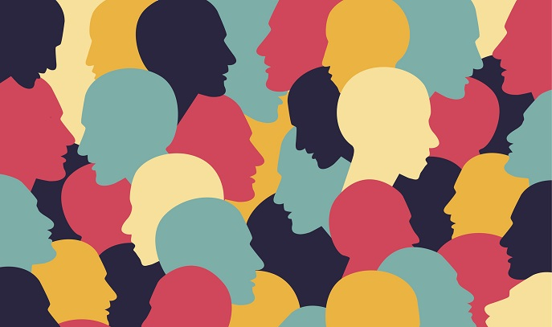
Notes:
C
<read notes>
Data collection is usually provided to us through real-world interactions. Which means that it may contain real-world bias. No data exists in a vacuum.
Understand that bias in data collection and analysis may be inevitable, but is not acceptable.
It’s not your responsibility to end bias (though that’s a worthy cause) – but rather to be aware of it.
You have an ethical responsibility to acknowledge, control for, and not further bias.
<next>
Look at bias outcomes, not in intents or origins.
Outcomes are how bias is measured.
The world doesn’t care if we intended to be un-biased. It cares that we were or were not biased – so it’s all about the outcome.

Slide 22
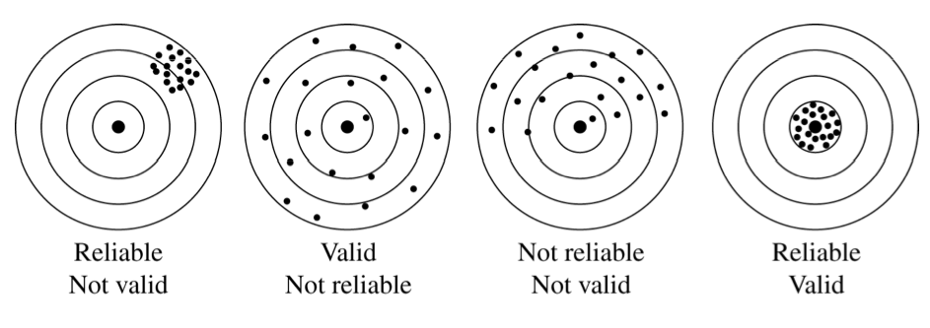
Validity & Reliability in Data
Notes:
C
<read notes>
Part of our ethical responsibility is looking at our methodologies and processes with data and knowing its statistical accuracy and inaccuracy.
Let’s look at some statistics 101. First we’ll start with What is validity? And what is reliability? Validity is the extent to which a concept, conclusion or measurement is well-founded and likely corresponds accurately to the real world.
Valid derived from Latin to mean “strong.” We’re pretty sure this is not just made up – it actually exists out there and tells a story of something true. But more importantly validity means – we sought out to answer a question (bullseye) and we’re pretty sure this data, this system, this analysis answers that “real-world” question.
Reliability – consistency, we can do this test, run this system, predict this thing happening over and over again and we know it to be true; “have confidence in the results ”.
Another way to think of this is, if you are reliably wrong, like in the leftmost example here, your outcomes are systemically biased, you’re providing solid data, but with an unresolved variable skewing the results.

Slide 23
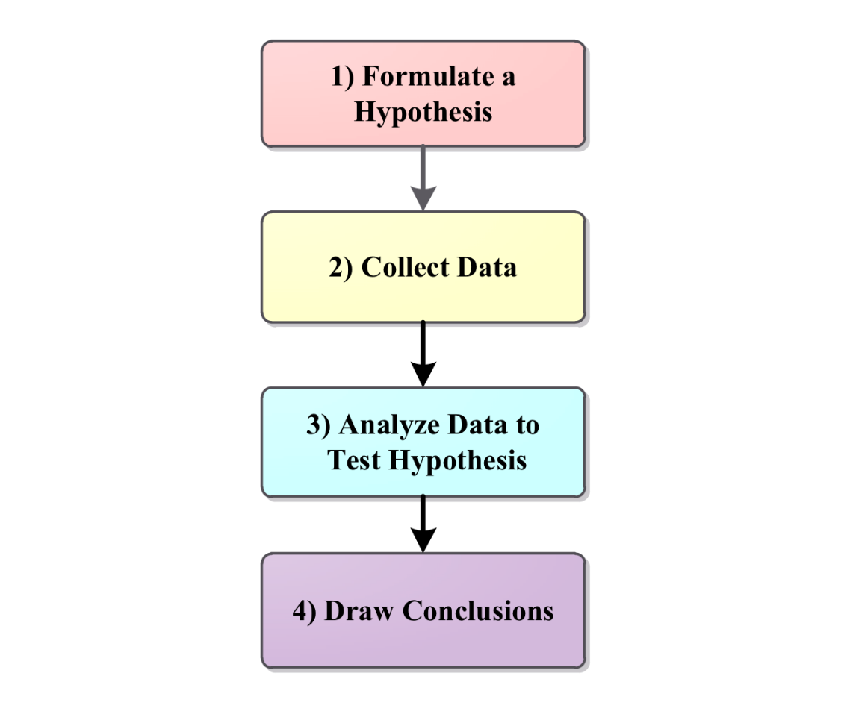
Validity & Reliability in Data
How do we prove something we’ve gathered is valid and reliable?
Hypothesis testing!
Can we truly say our conclusions are valid and reliable?
Notes:
C
<read notes>
So how do we prove something we’ve gathered is both valid and reliable?
Through hypothesis testing! Typically, that means we Formulate a Hypothesis, Collect Data, analyze the data to test the hypothesis and then draw our conclusions. But if our data is skewed, our analysis will also be skewed, and we may draw incorrect conclusions.
To put another way, if our collection methods lack credibility,
or our analysis fails to see all the variables in our data, then can we truly say our conclusions are valid and reliable?
But how can we overcome what we don’t know? There’s a few ways:
“independent verification” by consultants or other business entities
SMEs, outside perspectives, third-party analysis
Or simply more diversity of thought in our analysis, which means including people on our teams who have different life experiences than our own, who can give us insights into variables we may have missed… <more on that in the next slide>

Slide 24
Diversity Aids Validity, Counters Bias
“It’s difficult to build technology that serves the world without first building a team that reflects the diversity of the world… A more diverse group of researchers and engineers is more likely to recognize and think harder about bias problems that may even impact them personally.”¹ - Brad Smith, Microsoft, President
¹ Smith, Brad. Tools and Weapons, 2019
Notes:
C
<read notes>
In his 2019 book Tools and Weapons, Brad Smith with Microsoft wrote “It’s difficult to build technology that serves the world without first building a team that reflects the diversity of the world… A more diverse group of researchers and engineers is more likely to recognize and think harder about bias problems that may even impact them personally.”
In IT we know we need complex teams to solve complex problems. We know diverse teams are more productive.
Let’s look at some more examples of bias…

Slide 25
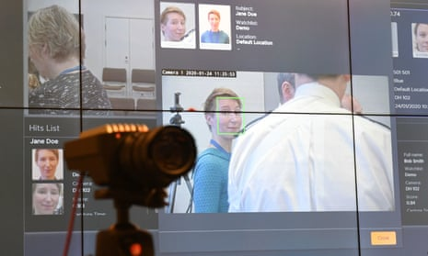
Facial Recognition Technology
“4 out of 5 people (81%) identified by facial recognition technology as suspects are innocent.”^{1,2}
“…falsely identified African-American and Asian faces 10 to 100 times more than Caucasian faces.”³
1 https://www.theguardian.com/technology/2020/jan/24/met-police-begin-using-live-facial-recognition-cameras
2 https://news.sky.com/story/met-polices-facial-recognition-tech-has-81-error-rate-independent-report-says-11755941?
3 https://www.nytimes.com/2019/12/19/technology/facial-recognition-bias.html
Notes:
C
<read notes>
This isn’t the first time we’re gonna mention facial recognition products in this presentation.
In January of 2020 in the United Kingdom, 81% of people identified as suspects by the Metropolitan Police’s facial recognition technology were - in fact - innocent.
This same technology falsely identified African-American and Asian faces 10-to-100 times more often than white faces.
Without validity or reliability, is it ethical to use a facial recognition software that has pervasive access to public camera systems?
Do we expect transparency about the flaws in such a system?
Let’s now talk more about the need for transparency.

Slide 26

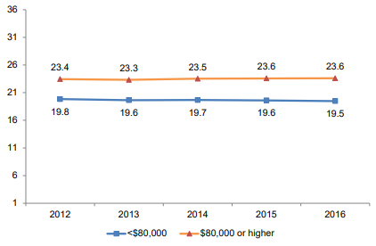
The ACT Test
Measures what students learned in school (valid).
Repeated testing gets similar results (reliable).
In 2016, ACT admitted Family Income explains performance on their test.¹
“More than 1,000 [colleges] have adopted test-optional admissions policies.”²
1 https://www.act.org/content/dam/act/unsecured/documents/R1604-ACT-Composite-Score-by-Family-Income.pdf 2 https://www.usnews.com/news/the-report/articles/2018-10-26/the-new-opt-out-movement-colleges-make-entrance-exams-optional 3 https://www.act.org/content/dam/act/unsecured/documents/5688-data-byte-2016-5-adjusted-differences-in-act-scores-by-family-income.pdf 4 Image: Corporate logo on ACT.org 5 https://www.wsj.com/articles/sat-to-go-digital-11643115606 6 https://19thnews.org/2022/03/colleges-admissions-dropping-sat-exam-gender-gap/
Notes:
C <read notes>
Many Americans are familiar with the ACT Test, an exam many 18 year olds take as part of their college application process.
ACT has long since stated that the test measures what students learned in school (which means it’s valid). And that repeated testing (if a student takes it over and over again) they’ll get similar results (which means its reliable).
However, in 2016, ACT admitted that family income is a major factor on their test. There is a 3 to 4 point difference between students in poorer and richer households, the line here being at 80 thousand dollars per year. That the gap is widening, according to their own data.
Credit to ACT for disclosing the research here which shows a widening gap among students based on family income.
Later, they tried to explain this gap by indicating that lower-income students also had “lower high school GPAs and less rigorous coursework.” Again, credit to them for at least acknowledging this, but is the ACT ethically testing for high school achievement, or, for opportunity?
If our measurements are valid and reliable, but outcomes are rejected, should we challenge our testing?
Our results are valid as tested, but what about the outcomes? Are they ethical? Are they to be trusted as the result of an impartial algorithm?
In this ACT example, socioeconomic level is a variable – it affects the outcome. What other variables may affect a student’s ACT score, variables that have been studied?
Class size?
Air quality and temperature of classrooms?
Local crime statistics? Recent local natural disasters Opportunity for private tutoring ?
Home schooled? Public school? Private school?
Number of hours students work a job outside of school?
This year, more than 76% of all four-year colleges and universities won’t mandate an entrance exam score for admissions.⁵ This might question the validity of ACT’s test in terms of what colleges want out of the score, given that so many schools disregard its validity. In addition to performance gaps based on student household wealth, studies going back to the 1980s have shown unfair disparity in outcomes based on gender while under-predicting women’s academic achievement in college.⁶
An overwhelming amount of studies have been done that say the ACT does NOT predict college graduation outcomes. In fact, a bigger factor that impacts graduation outcomes remains household income.

Slide 27
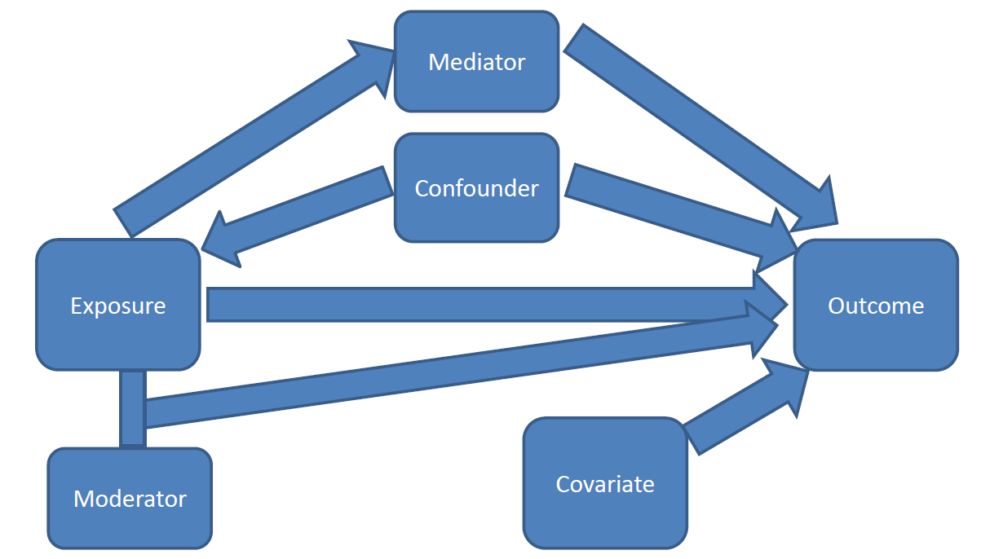
Knowing the Variables
Mediator
Confounder
Moderator
Covariate
You will never find the variables unless you’re looking for them.
Ask: “Are there any other variables that affect the data?”
https://significantlystatistical.wordpress.com/2014/12/12/confounders-mediators-moderators-and-covariates/
Notes:
C
<read notes>
Knowing the variables that are involved in your analysis is important – just as we saw with the ACT.
When conducting analysis, most researchers will review, identify, and map out the variables.
Let’s briefly go through the definitions of some variables and then I’ll give an example that will make the clearer.
<click>
First, understand that mediators and confounders are similar, except for the affect or direction they have on exposure and outcome.
Mediators are considered to be “the causal pathway” between exposure and outcome. Which means they seem to naturally occur. <click>
Confounders directly affect both exposure and outcome.
<click>
Moderators are simply interactions that change the size or direction of the effect of the exposure on outcome. It makes the outcome smaller or larger. <click>
And Covariates are variables that might affect outcomes but really are not associated with anything else.
You will never find the variables unless you’re looking for them.
Ask yourself: “Are there any other variables that affect the data?”
There will always be other variables made apparent when you dig. Sometimes you never see them until after your data collection is complete.
Now let’s look at an example…

Slide 28
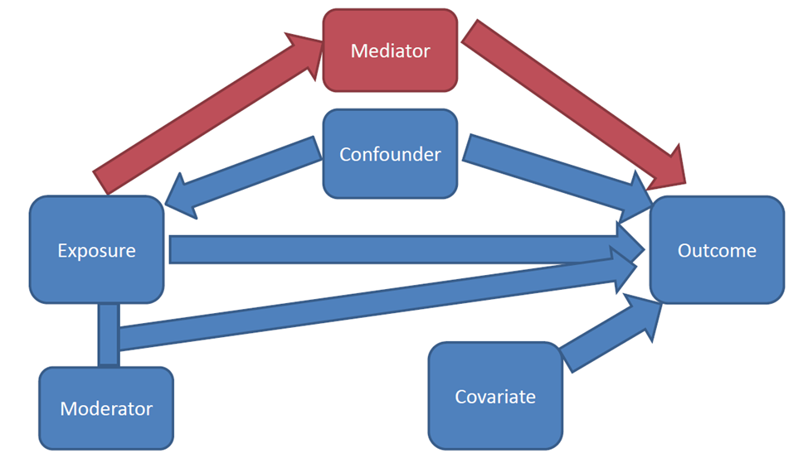
Knowing the Variables
Mediator
Confounder
Moderator
Covariate
You will never find the variables unless you’re looking for them.
Ask: “Are there any other variables that affect the data?”
https://significantlystatistical.wordpress.com/2014/12/12/confounders-mediators-moderators-and-covariates/
Notes:
C
First, understand that mediators and confounders are similar, except for the affect or direction they have on exposure and outcome.
Mediators are considered to be “the causal pathway” between exposure and outcome. Which means they seem to naturally occur. <click>
Confounders directly affect both exposure and outcome.
<click>
Moderators are simply interactions that change the size or direction of the effect of the exposure on outcome. It makes the outcome smaller or larger. <click>
And Covariates are variables that might affect outcomes but really are not associated with anything else.
You will never find the variables unless you’re looking for them.
Ask yourself: “Are there any other variables that affect the data?”
There will always be other variables made apparent when you dig. Sometimes you never see them until after your data collection is complete.
Now let’s look at an example…

Slide 29
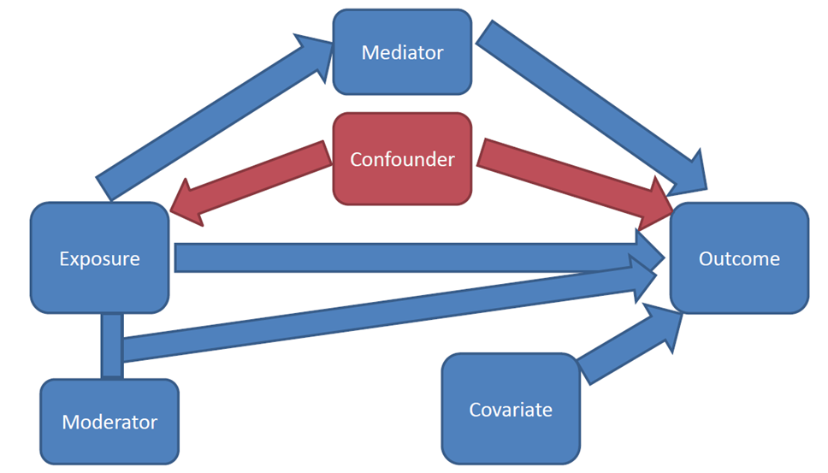
Knowing the Variables
Mediator
Confounder
Moderator
Covariate
You will never find the variables unless you’re looking for them.
Ask: “Are there any other variables that affect the data?”
https://significantlystatistical.wordpress.com/2014/12/12/confounders-mediators-moderators-and-covariates/
Notes:
C
Confounders directly affect both exposure and outcome.
<click>
Moderators are simply interactions that change the size or direction of the effect of the exposure on outcome. It makes the outcome smaller or larger. <click>
And Covariates are variables that might affect outcomes but really are not associated with anything else.
You will never find the variables unless you’re looking for them.
Ask yourself: “Are there any other variables that affect the data?”
There will always be other variables made apparent when you dig. Sometimes you never see them until after your data collection is complete.
Now let’s look at an example…

Slide 30
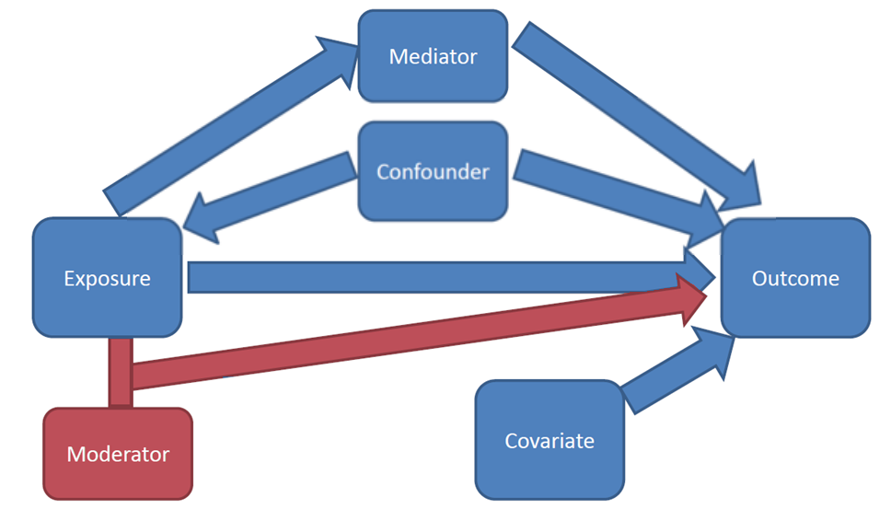
Knowing the Variables
Mediator
Confounder
Moderator
Covariate
You will never find the variables unless you’re looking for them.
Ask: “Are there any other variables that affect the data?”
https://significantlystatistical.wordpress.com/2014/12/12/confounders-mediators-moderators-and-covariates/
Notes:
C
Moderators are simply interactions that change the size or direction of the effect of the exposure on outcome. It makes the outcome smaller or larger. <click>
And Covariates are variables that might affect outcomes but really are not associated with anything else.
You will never find the variables unless you’re looking for them.
Ask yourself: “Are there any other variables that affect the data?”
There will always be other variables made apparent when you dig. Sometimes you never see them until after your data collection is complete.
Now let’s look at an example…

Slide 31
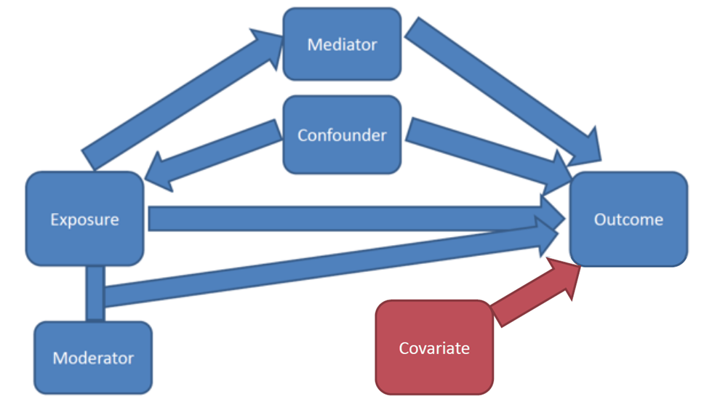
Knowing the Variables
Mediator
Confounder
Moderator
Covariate
You will never find the variables unless you’re looking for them.
Ask: “Are there any other variables that affect the data?”
https://significantlystatistical.wordpress.com/2014/12/12/confounders-mediators-moderators-and-covariates/
Notes:
C
And Covariates are variables that might affect outcomes but really are not associated with anything else.
You will never find the variables unless you’re looking for them.
Ask yourself: “Are there any other variables that affect the data?”
There will always be other variables made apparent when you dig. Sometimes you never see them until after your data collection is complete.
Now let’s look at an example…

Slide 32
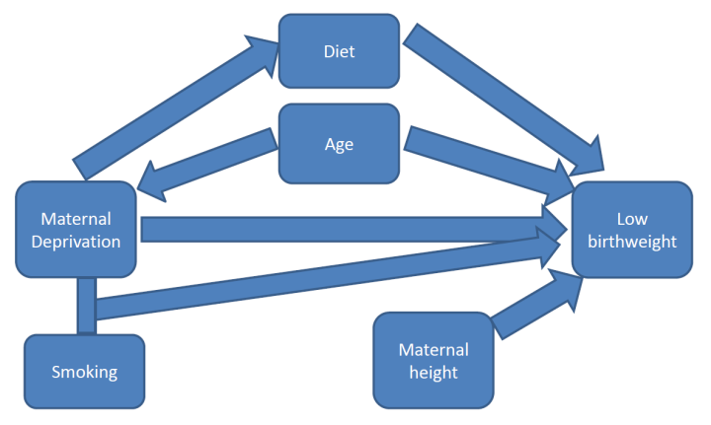
Mediator:
Diet
Confounder:
Age
Moderator:
Smoking
Covariate:
Maternal height
https://significantlystatistical.wordpress.com/2014/12/12/confounders-mediators-moderators-and-covariates/
https://bmjopen.bmj.com/content/4/4/e004514
Notes:
C
<read notes>
We’re going to look at the relationship between poor mothers (shown here as “maternal deprivation”) and low birthweight. We know this to be true. Maternal deprivation (Poor mothers) give birth to babies with lower birthweight. It’s been tested over and over again. This is based on a study to investigate trends in birth rates by socioeconomic deprivation and maternal age in England from 1997 to 2008.
But why? What are the variables that surround it?
Let’s look at our variables…

Slide 33
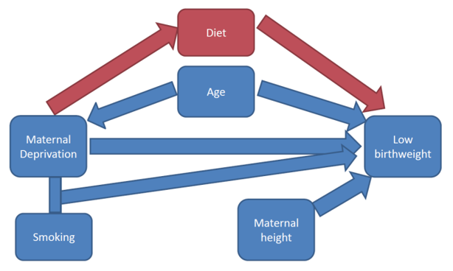
Mediator:
Diet
Confounder:
Age
Moderator:
Smoking
Covariate:
Maternal height
https://significantlystatistical.wordpress.com/2014/12/12/confounders-mediators-moderators-and-covariates/
Notes:
C
Mediator here is diet. Remember Mediator is the “the causal pathway” it’s said to be “naturally occurring”. In this case diet could be due to being poor, and a sub-optimal diet of the mother who is nourishing the unborn child means the baby would be smaller. Usually a mediator variable is something you can’t avoid in your data. It exists and you just need to be aware of it.
<click>
The confounder variable is age here. Remember that confounders affect both the exposure (poor mothers) and the outcome (low birthweight). In our analysis Maternal age may affect poverty (perhaps the younger a mother is, the less money she has, or she could be physically less developed as an older adult woman) and therefore her age is may be associated with low birthweight. This variable could be controlled for, though. We could look, for example, only at mothers of certain ages. <click>
Now remember the moderator affects the size or direction of our outcome. In this case the moderator is smoking. There’s an interaction between poor mothers and smoke exposure on birthweight. Meaning poor mothers tend to smoke which produce babies even smaller. Again, we can control for it if we wanted to. We could look at data for mothers who don’t smoke, or only for those who do.
<click>
Lastly our Covariate here is height. Remember, that this variable is for things we need to account for - because we think they are related to outcome (but really connected to nothing else). Height here could be a factor, but it doesn’t affect the exposure but maybe the outcome. Again, this would be a variable we’d control for in an experiment, but we may or may not be able to.
This brings a great point - When presented with data you may or may not have the ability to “control” for your variables.
Can you remove some variables and not others?
And how do you choose which variables to account for?
What is the reasoning behind your decisions?
Clearly describing where we think or predict the interactions, relationships or pathways exist in our data and our work is incredibly powerful.
Mapping, reviewing, analyzing our data for all the variables that could bias our data can help in mitigating bias.

Slide 34
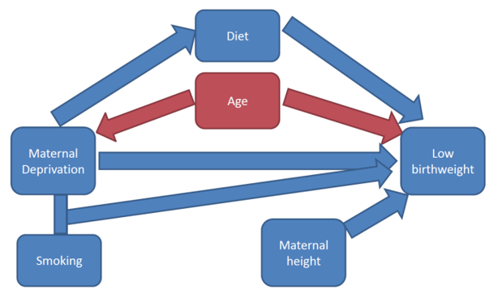
Mediator:
Diet
Confounder:
Age
Moderator:
Smoking
Covariate:
Maternal height
https://significantlystatistical.wordpress.com/2014/12/12/confounders-mediators-moderators-and-covariates/
Notes:
C
The confounder variable is age here. Remember that confounders affect both the exposure (poor mothers) and the outcome (low birthweight). In our analysis Maternal age may affect poverty (perhaps the younger a mother is, the less money she has, or she could be physically less developed as an older adult woman) and therefore her age is may be associated with low birthweight. This variable could be controlled for, though. We could look, for example, only at mothers of certain ages.
<click>
Now remember the moderator affects the size or direction of our outcome. In this case the moderator is smoking. There’s an interaction between poor mothers and smoke exposure on birthweight. Meaning poor mothers tend to smoke which produce babies even smaller. Again, we can control for it if we wanted to. We could look at data for mothers who don’t smoke, or only for those who do.
<click>
Lastly our Covariate here is height. Remember, that this variable is for things we need to account for - because we think they are related to outcome (but really connected to nothing else). Height here could be a factor, but it doesn’t affect the exposure but maybe the outcome. Again, this would be a variable we’d control for in an experiment, but we may or may not be able to.
This brings a great point - When presented with data you may or may not have the ability to “control” for your variables.
Can you remove some variables and not others?
And how do you choose which variables to account for?
What is the reasoning behind your decisions?
Clearly describing where we think or predict the interactions, relationships or pathways exist in our data and our work is incredibly powerful.
Mapping, reviewing, analyzing our data for all the variables that could bias our data can help in mitigating bias.

Slide 35
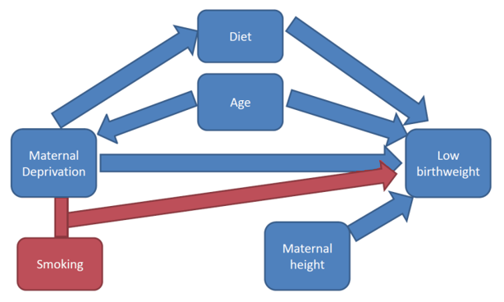
Mediator:
Diet
Confounder:
Age
Moderator:
Smoking
Covariate:
Maternal height
https://significantlystatistical.wordpress.com/2014/12/12/confounders-mediators-moderators-and-covariates/
Notes:
C
Now remember the moderator affects the size or direction of our outcome. In this case the moderator is smoking. There’s an interaction between poor mothers and smoke exposure on birthweight. Meaning poor mothers tend to smoke which produce babies even smaller. Again, we can control for it if we wanted to. We could look at data for mothers who don’t smoke, or only for those who do.
<click>
Lastly our Covariate here is height. Remember, that this variable is for things we need to account for - because we think they are related to outcome (but really connected to nothing else). Height here could be a factor, but it doesn’t affect the exposure but maybe the outcome. Again, this would be a variable we’d control for in an experiment, but we may or may not be able to.
This brings a great point - When presented with data you may or may not have the ability to “control” for your variables.
Can you remove some variables and not others?
And how do you choose which variables to account for?
What is the reasoning behind your decisions?
Clearly describing where we think or predict the interactions, relationships or pathways exist in our data and our work is incredibly powerful.
Mapping, reviewing, analyzing our data for all the variables that could bias our data can help in mitigating bias.

Slide 36
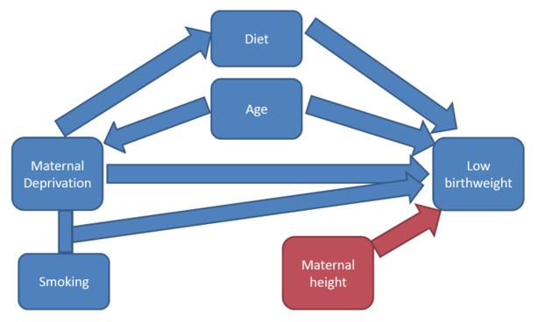
Mediator:
Diet
Confounder:
Age
Moderator:
Smoking
Covariate:
Maternal height
https://significantlystatistical.wordpress.com/2014/12/12/confounders-mediators-moderators-and-covariates/
Notes:
C
Lastly our Covariate here is height. Remember, that this variable is for things we need to account for - because we think they are related to outcome (but really connected to nothing else). Height here could be a factor, but it doesn’t affect the exposure but maybe the outcome. Again, this would be a variable we’d control for in an experiment, but we may or may not be able to.
This brings a great point - When presented with data you may or may not have the ability to “control” for your variables.
Can you remove some variables and not others?
And how do you choose which variables to account for?
What is the reasoning behind your decisions?
Clearly describing where we think or predict the interactions, relationships or pathways exist in our data and our work is incredibly powerful.
Mapping, reviewing, analyzing our data for all the variables that could bias our data can help in mitigating that bias.

Slide 37
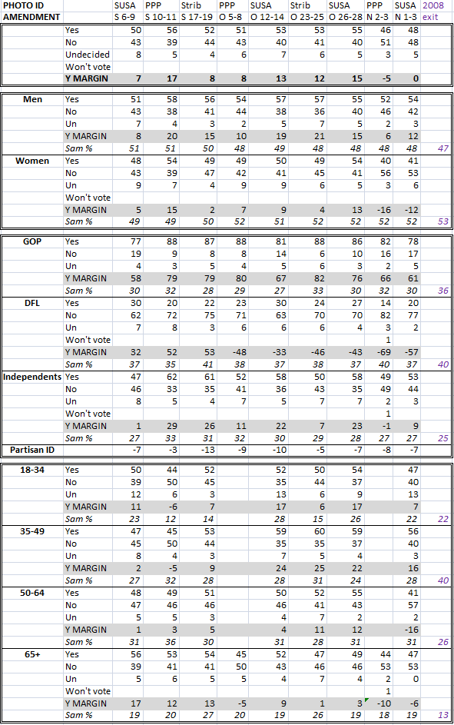
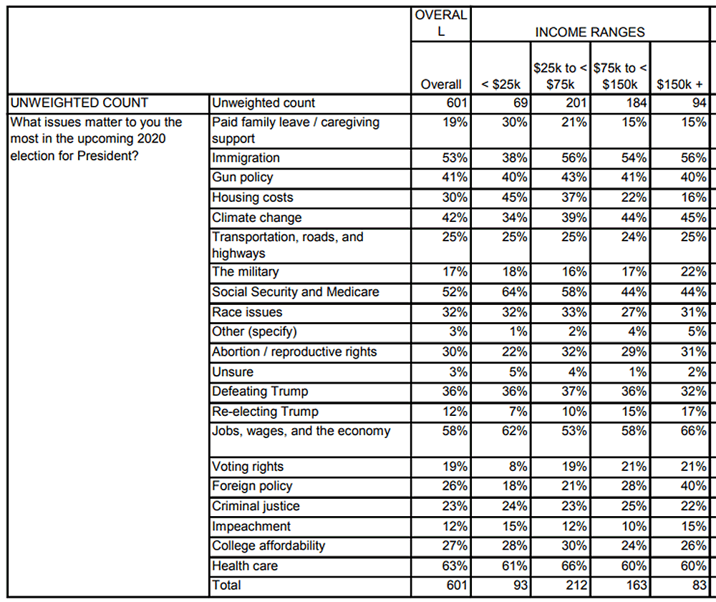
Election Polling
Non-traditional political pollsters are mysteriously more accurate when there is a “gold standard” poll in the same race.¹
A “gold standard” poll is a live phone call survey.
There is an urge to mold data to fit others’ findings, so that we don’t appear to be a fringe source.²
Polling data should always provide the crosstabs.
¹ https://fivethirtyeight.com/features/are-bad-pollsters-copying-good-pollsters/
² https://fivethirtyeight.com/features/pollsters-say-they-follow-ethical-standards-but-they-arent-so-sure-about-their-peers/
Example crosstabs Image (L): https://www.minnpost.com/braublog/2012/11/super-crosstabs-obama-soars-photo-id-plunges-marriage-amendment-slips/
Example crosstabs Image (R): https://www.wbur.org/news/2019/09/11/wbur-issue-survey-takeaways
Notes:
WILLIAM
<read the notes>
Let’s talk about transparency as part of overcoming bias. Here’s an example from the United States where political pollsters may have altered their data to fit the competition
In a study by the website 538, non-traditional pollsters (like online surveys or automated systems) were “allegedly” cheating by peeking at “gold standard” poll. A “gold standard” poll is a live person to person phone call survey. Non-traditional political polls are mysteriously more accurate when there is a “gold standard” poll in the same election, and less accurate when there is not a “gold standard” poll.
So when there was a “gold standard” for that election, the non-traditional polls were more accurate.
No “gold standard” for a small election in Alaska? The non-traditional polls were less accurate.
<next>

Slide 38
Election Polling
Non-traditional political pollsters are mysteriously more accurate when there is a “gold standard” poll in the same race. Less accurate when no “gold standard” poll.¹
There is an urge to mold data to fit others’ findings, so that we don’t appear to be a fringe source.²
Polling data should always provide the crosstabs.
¹ https://fivethirtyeight.com/features/are-bad-pollsters-copying-good-pollsters/
² https://fivethirtyeight.com/features/pollsters-say-they-follow-ethical-standards-but-they-arent-so-sure-about-their-peers/
Example crosstabs Image (L): https://www.minnpost.com/braublog/2012/11/super-crosstabs-obama-soars-photo-id-plunges-marriage-amendment-slips/
Example crosstabs Image (R): https://www.wbur.org/news/2019/09/11/wbur-issue-survey-takeaways
Notes:
WILLIAM
<read the notes>
A couple examples here of the “crosstabs” in a political poll. A detailed data table of the polling results, per demographic breakdown, per question. A common response to big or sensational headlines about political poll results should always be, “show the crosstabs”.
Transparency should include not only the “crosstabs” of your results, but a disclosure/discussion of known historical biases.
Your data tells a story – there may be a tendency to want manipulate the data to fit the story you want to tell. How can you “show the crosstabs”, show the detail and the proof, in your work?

Slide 39
Disclosure of Bias
“Every scientist should therefore be aware of all potential sources of bias... If deviation is still present, authors should confess it in their articles by declaring the known limitations of their work.”¹
¹ https://www.ncbi.nlm.nih.gov/pmc/articles/PMC3900086/
Notes:
C
This is a quote from a paper published in the journal Biochemia Medica.
<read quote>
Failure to provide that transparency begs accusations of a biased interpretation.

Slide 40
Apple Credit Card (2019)
“No one from Apple seemed able to describe how the algorithm even worked, let alone justify its output. While Goldman Sachs, the issuing bank for the Apple Card, insisted that there isn't any gender bias in the algorithm, it failed to offer proof.”¹
¹ https://www.wired.com/story/the-apple-card-didnt-see-genderand-thats-the-problem/
² https://www.nytimes.com/2019/11/10/business/Apple-credit-card-investigation.html
Notes:
C
<read notes>
Let’s look at an example with biased outcomes and no transparency.
In 2019, Apple issued Credit Cards and men were given higher credit limits than women, even higher than their wives.
How could this be? Could women’s income inequality be a variable? Women’s income inequality provides a historically biased look at gender.
A quote from Wired Magazine, “No one from Apple seemed able to describe how the algorithm even worked, let alone justify its output. While Goldman Sachs, the issuing bank for the Apple Card, insisted that there isn't any gender bias in the algorithm, it failed to offer proof.”
This is an example of Apple not even being AWARE of their bias, much less disclosing it publicly (which would have been embarrassing).
Apple is now being investigated by regulators.² – so these kind of errors may result in legal implications.
One could be challenged on disparate impact (particularly in employment areas) – we’ll talk about disparate impact a bit later.

Slide 41
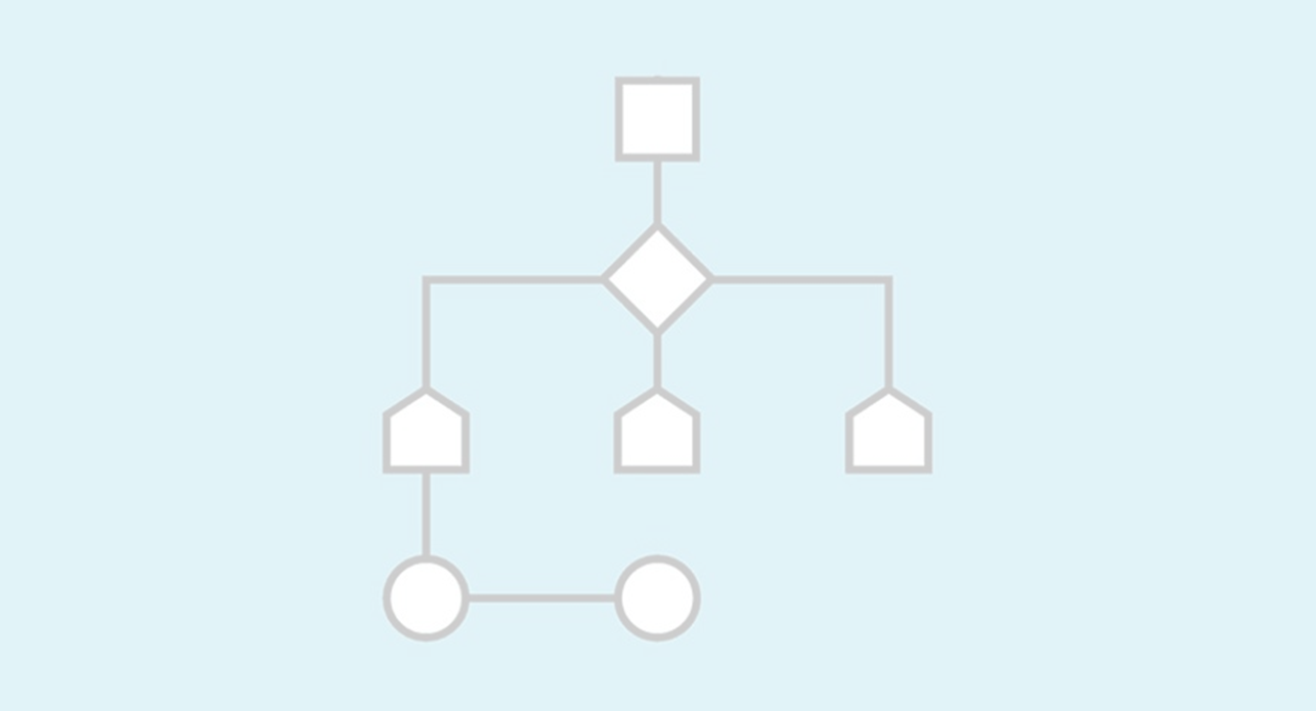
Support Your Conclusions
Notes:
C
You need to be able to support your conclusions.
That’s why we’re talking about steroids, censorship, race, facial recognition, Apple cards.
Transparency to how the algorithm works is key to acknowledging bias in outcomes.
In the case of competitive Intellectual Property, the algorithm should be understood at least internally.
It cannot be a mysterious black box, and yes, we’ll talk about just such an example later.

Slide 42
Data Collection
Notes:
WILLIAM
Let’s dive deeper into this ethical problem.
We’ve talked about transparency in analysis,
let’s talk about ethics in data collection.

Slide 43
Ethics in Data Collection
“The specific responsibilities of individuals, government, corporations, and the network of friends, partners, and other third parties who may come into possession of personal data have yet to be worked out. The technological trajectory, however, is clear: more and more data will be generated about individuals and will persist under the control of others.” –Big Data: Seizing Opportunities, Preserving Values. Executive Office of the President of the United States, 2014¹
¹ https://obamawhitehouse.archives.gov/sites/default/files/docs/big_data_privacy_report_5.1.14_final_print.pdf
Notes:
WILLIAM
<read notes>
So this from a report from the White House in 2014, keys here are that
1) data will be collected on individuals, and
2) data will be not be owned by those individuals
What are our ethical responsibilities in collection and ownership of citizens’ data?
Let’s go over a couple bad examples.

Slide 44
Target’s Scandal re: Pregnant Daughter
Ethical collection: consumer retail shopping habits from Target stores
Unethical use: expectant mother coupons (to a high schooler who’d been hiding pregnancy)
“We are very conservative about compliance with all privacy laws. But even if you’re following the law, you can do things where people get queasy.”¹
¹ https://www.nytimes.com/2012/02/19/magazine/shopping-habits.html?pagewanted=1&_r=1&hp
Notes:
WILLIAM
<read the notes>
You may be familiar with the story about American retailer Target’s direct mail campaign for expectant mothers and a furious dad, who didn’t know his teenage daughter was pregnant yet.
Quote is from Andrew Pole, the Target statistician who developed the store’s model for predicting and detecting consumer pregnancies, which were then used to target ads to expectant mothers.
<read quote>
Ethical collection, unethical use, resulting in a violation of privacy for a sensitive topic. What if this ad arrived shortly after a miscarriage? It’d be different if Target were, say, sending mailers people about to buy shoes, or toys, or a car, but a pregnancy?
Target’s statistician says that even if you’re following privacy laws and regulations, you still may trip over ethical lines.

Slide 45
Facebook + Cambridge Analytica
Gathered data on 87MM+ users without consent.
Hired by the Trump campaign, used to micro-target Facebook users, shared internationally.
Whistleblower: CA shared data with Russian proxies for “rumour campaigns”, “attitudinal inoculation”¹, and “psychological warfare.”²
1 https://www.youtube.com/watch?v=Zy16v0oIo3s 2 https://www.npr.org/2018/05/16/611412562/whistleblower-cambridge-analytica-aimed-to-trigger-paranoia-and-racial-biases 3 https://www.vox.com/policy-and-politics/2018/3/23/17151916/facebook-cambridge-analytica-trump-diagram 4 https://www.vox.com/policy-and-politics/2017/10/16/15657512/cambridge-analytica-facebook-alexander-nix-christopher-wylie
Notes:
WILLIAM
<read the notes>
British firm Cambridge Analytica gathered the data on 87+ million Facebook users without their consent, via what Facebook later labeled “malicious” use of its developer system. Any user who took their custom Facebook “personality quiz” also - unknowingly - allowed CA to access their personal data and the personal data - including location - for all their “friends”. Clearly, unethical collection.
<next>
CA used the data to perform “Digital Operations” to target future president Trump’s 2016 campaign messaging, using quote “5000 points of data on every voter”, to set the campaign travel schedule, platform, and to micro-target Facebook users with $1 million dollars a day in ads. Maybe that’s not unethical use, but it was based on unethically collected data.
<next>
These quotes you see here are from the Cambridge Analytica data analyst Christopher Wylie, turned whistle blower who testified in both the US and UK in 2018.³
CA later shared the Facebook data with Russian proxies for “rumour campaigns” and “attitudinal inoculation”¹, and “psychological warfare.”²
Wylie, when we worked at CA, did not believe their collection and analysis was unethical. He does now.

Slide 46
Consent
Where is it recorded that users signed off on the privacy policy?
Where is it recorded that participants asked to be contacted in the future, or on a “do not call” list?
Are we transparent about our use or potential re-use of the data?
Does our approach rely on consumers being gullible, or tricking consumers?
Notes:
WILLIAM
<read notes, then slide>
Analysts must be aware of consent mechanisms, both how they were collected, and more logistically, how this data on consent can be incorporated into future analysis.

Slide 47
Control Creep
“Control creep" refers to data that has been generated with a particular purpose in mind, but which is repurposed.
For example, harvesting consumer data for research purposes, then selling the data, or, using genetic data for employment.
¹ https://www.genome.gov/10001732/genetic-information-and-the-workplace-report
² https://www.eeoc.gov/laws/guidance/enforcement-guidance-disability-related-inquiries-and-medical-examinations-employees
³ https://webcache.googleusercontent.com/search?q=cache:LmaFv_ORZKEJ:https://rct.learningpool.com/pluginfile.php/711/mod_folder/content/0/Saesneg%2520-%2520English/Factsheet%2520on%2520Sickle%2520Cell%252012_13.doc.pdf%3Fforcedownload%3D1+&cd=1&hl=en&ct=clnk&gl=us
⁴ https://news.bloomberglaw.com/daily-labor-report/employers-cant-require-back-to-work-antibody-tests-eeoc-says
Notes:
WILLIAM
<read notes>
Let’s talk more about that “potential re-use” of data. “Control creep" refers to data that has been generated with a particular purpose in mind, but which is repurposed.
<click>
Can you think of genetic data example that has been identified as having a disparate impact, that is now federally banned in the U.S. for use in hiring?
For example, employers in the United States used genetic screening in the early 1970s to identify potential employees who carried a gene mutation for sickle cell anemia, a periodically debilitating genetic disorder that is predominant in African Americans. “Those carrying the gene mutation were denied jobs-even though many of them were healthy and would never develop the disease.”¹
In the United States, Americans with Disabilities Act of 1990 put an end to sickle cell trait discrimination in employment and its disparate outcomes on race.² In the UK, the Equality Act 2010 provided for the same.³ Now, you’ll likely see a poster for this in the break room at work, outlining the prohibition on sickle cell trait discrimination.
Similarly, a genetic test for expensive cancers must not be a prerequisite for joining an employer’s health care coverage. That would be, unethical.
As personal health data devices and services become more prevalent in our society, let’s be aware of potential misuse and discrimination based on predictive health markers.

Slide 48
Control Creep
Unethical, potentially illegal re-purposing of financial data
Using financial data for health care marketing is potentially predatory or discriminatory, and vice versa.
Bias from of socioeconomic trends
“Weblining” is the use of financial data to target users for online ads including childcare, housing, health care.¹
1 https://www.researchgate.net/publication/266910451_The_Good_the_Bad_and_the_Ugly_Applying_Rawlsian_Ethics_In_Data_Mining_Marketing
Notes:
WILLIAM
<read notes>
Using financial data for health care research is potentially predatory or discriminatory, and vice versa, where only wealthy patients are told about the best and more expensive treatments.
<next>
This also leads to a relatively new concept of “Weblining”, or the use of financial data to target users for online ads including childcare, housing, health care.¹ This is a play of words on Redlining, which we’ll talk more about soon. Financial data may be predatory if lower income consumers are targeted with subprime lending, high interest credit cards, or high-fee banking advertisements.
We should be aware, and transparent, of potential control creep in data we control.

Slide 49
Disparate Impact
Notes:
CHRISTINE
We’ll talk more about Weblining later, because it can contribute to digitizing an Disparate Impact. We mentioned this earlier with the Apple Card algorithm having a disparate impact on women, of facial recognition’s disparate impact on darker-skinned individuals.
Most systems (selection systems especially) are built to intend to discriminate meaning they create distinctions among people. (repeat)
But there’s various laws about discrimination on the basis of age, gender, race, etc., these laws are most notably around employment, housing, public accommodation…
In the United States for example, there are two forms of ILLEGAL discrimination:
Disparate treatment (active discrimination towards individuals): intentional and open bias, retaliation, or exclusionary
Disparate (adverse) impact (passive discrimination): towards groups. You’re sometimes unaware they exist in your systems.

Slide 50
“Disparate impact recognizes that implicit biases can produce discriminatory results
— even without intent — and allows for such results to be remedied.”
¹ https://www.nytimes.com/roomfordebate/2015/04/27/can-discrimination-exist-without-clear-intent/unintentional-discrimination-is-as-harmful-as-real-bias
Notes:
CHRISTINE
In the case of housing discrimination, the doctrine of “disparate impact recognizes that implicit biases can produce discriminatory results — even without intent — and allows for such results to be remedied.”¹
Analytical models or predictive models must either account for and be aware of past trends, or become guilty of continuing and institutionalizing past trends.
Your data analysis must expose and control for disparate impact, or will contribute to it.

Slide 51
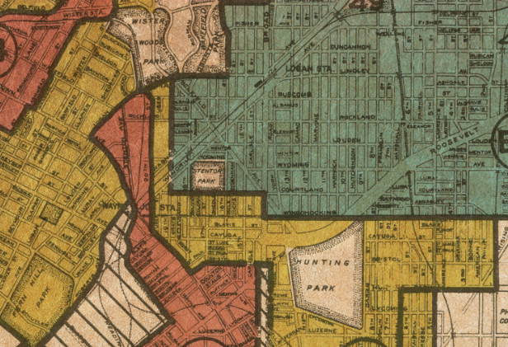
Redlining
1934-68: Federal Housing Authority (FHA) Redlining
1968: Fair Housing Act
1974: Equal Credit Opportunity Act
1977: Community Reinvestment Act
1 Image: University of Richmond digital scholarship lab Retrieved from: https://www.revealnews.org/article/for-people-of-color-banks-are-shutting-the-door-to-homeownership/
2 https://www.revealnews.org/article/for-people-of-color-banks-are-shutting-the-door-to-homeownership/ 3 https://www.washingtonpost.com/news/wonk/wp/2018/03/28/redlining-was-banned-50-years-ago-its-still-hurting-minorities-today/
Notes:
WILLIAM
<read notes>
A brief history of redlining: a term used in the United States and Canada to describe once-legal housing segregation.
Red lines were literally drawn on maps around “undesirable” minority neighborhoods, marking them as “undesirable” and hazardous for financing. This denied Federal housing authority-insured mortgages to minority families. Literally legalized disparate impact, by the FHA. Many of you as young people may have used the FHA-subsidized loans to make your first home purchase. We did.
In the 1930s, the FHA surveyed neighborhoods in 239 cities, color-coding them green for “best,” blue for “still desirable,” yellow for “definitely declining” and red for “hazardous.” The “redlined” areas were the ones local lenders considered unsuitable areas for investment, because of the residents’ racial and ethnic demographics.

Slide 52
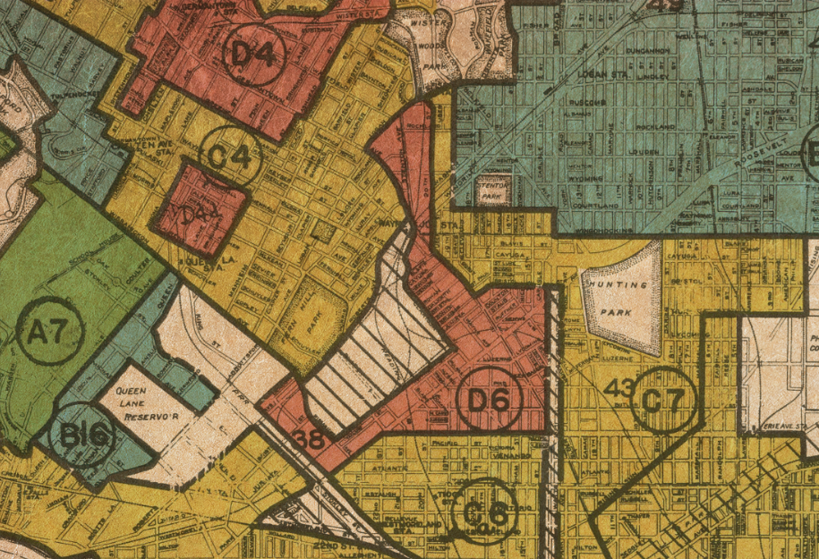
Redlining
1934-68: Federal Housing Authority (FHA) Redlining
1968: Fair Housing Act
1974: Equal Credit Opportunity Act
1977: Community Reinvestment Act
1 Image: University of Richmond digital scholarship lab Retrieved from: https://www.revealnews.org/article/for-people-of-color-banks-are-shutting-the-door-to-homeownership/
2 https://www.revealnews.org/article/for-people-of-color-banks-are-shutting-the-door-to-homeownership/ 3 https://www.washingtonpost.com/news/wonk/wp/2018/03/28/redlining-was-banned-50-years-ago-its-still-hurting-minorities-today/
Notes:
WILLIAM
<read notes>
This is an actual redlining map from 1937 from Philadelphia, Pennsylvania. Maps like this were used throughout the country. It wasn’t really undone in the U.S. until a series of laws 1970s required banks to meet the lending needs of low income neighborhoods.
The American Dream of home ownership was denied to “Baby Boomer” minorities, legally through the 1970s, and that generational gap continues today, fifty years later. 3 out of 4 neighborhoods “redlined” on government maps 80 years ago continue to struggle economically. And despite laws in place, disparate racial outcomes continue in housing. “Fifty years after the federal Fair Housing Act, African Americans and Latinos continue to be routinely denied conventional mortgage loans at rates far higher than their white counterparts.”³

Slide 53
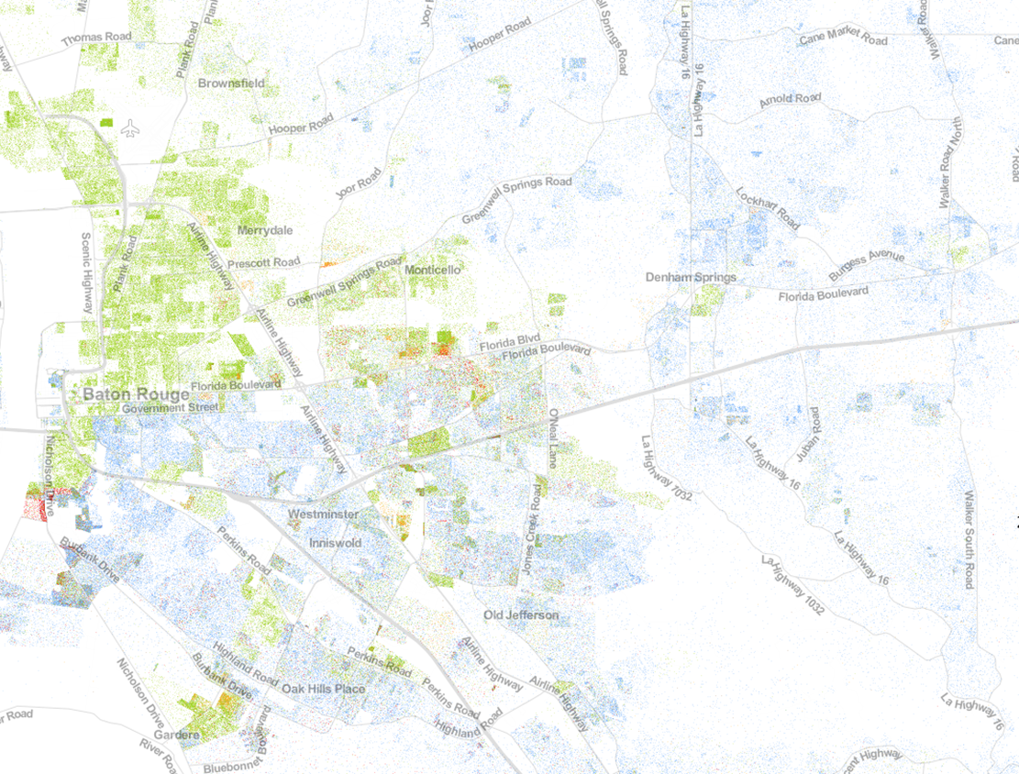
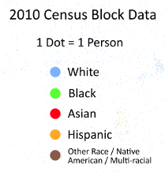
https://demographics.coopercenter.org/racial-dot-map
Notes:
WILLIAM
This is a racial dot map in my home town of Baton Rouge, Louisiana (in the United States). It shows racial demographic data from the 2010 US census.

Slide 54
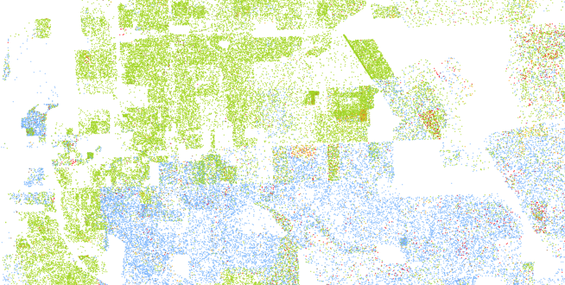
https://demographics.coopercenter.org/racial-dot-map
1 https://themarkup.org/still-loading/2022/10/19/dollars-to-megabits-you-may-be-paying-400-times-as-much-as-your-neighbor-for-internet-service
Notes:
See if you can spot Florida Blvd on this map, a historical redlining boundary.
If you’re a bank, your analysis on market segmentation may be furthering historical racial housing segregation if you are ignoring minority areas for special rate loan offers, ATM locations, service locations, assessments, etc. Even if you aren’t intending to exclude minorities from your financial services, by ignoring 85 years of racial subdividing, you may be extending that historical trend.
If you’re an internet service provider, offering the same prices for slower internet service in poorer areas, you are extending a historical trend. Sure enough, this year a joint investigation by the markup and the associated press found AT&T, Verizon, EarthLink, and CenturyLink disproportionately offered lower-income and least-White neighborhoods slow internet service for the same price as speedy connections they offered in other parts of town. (https://themarkup.org/still-loading/2022/10/19/dollars-to-megabits-you-may-be-paying-400-times-as-much-as-your-neighbor-for-internet-service)
If say, despite your best intentions, your outcome had a disparate impact on minorities you can only be judged by your outcomes, not by your best intentions.

Slide 55
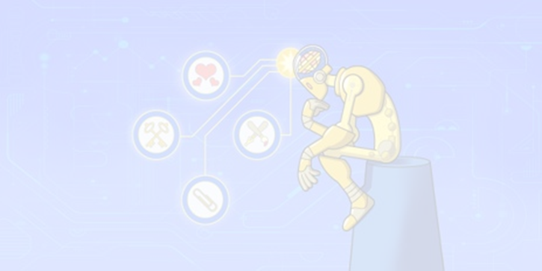
It is illegal and unethical to blame an algorithm to avoid penalties.
1 https://www.revealnews.org/article/can-algorithms-be-racist-trumps-housing-department-says-no/
2 https://www.nytimes.com/2019/08/20/upshot/housing-discrimination-algorithms-hud.html 3 https://www.eff.org/deeplinks/2019/09/dangerous-hud-proposal-would-effectively-insulate-parties-who-use-algorithms
Notes:
C
Only outcomes can measure disparate impact.
Disparate Impact is not based on intentions.
It is illegal, and unethical, for companies to blame an algorithm to avoid penalties. And there's some links here that you can read through to find the legal precedence for that.
There are decades of legal precedent, most recently upheld by the Supreme Court in 2015, that permit the use of statistical analysis to –identify- patterns of discrimination, but not excuse it.¹

Slide 56
“Weblining” or Digital Redlining
Collecting data, segmenting based on income, resulting in disparate offers, exposure.
“Social sorting” affects and inﬂuences both the choices and opportunities of proﬁled individuals.¹
Facebook allowed housing ads to target based on religion, race, sex, disability.²
A 2013 Harvard study found racial discrimination in Google’s Online Ad Delivery.³
¹ https://www.researchgate.net/publication/266910451_The_Good_the_Bad_and_the_Ugly_Applying_Rawlsian_Ethics_In_Data_Mining_Marketing
² https://www.hud.gov/press/press_releases_media_advisories/HUD_No_19_035 ³ https://dataprivacylab.org/projects/onlineads/1071-1.pdf
Notes:
C
<read notes>
We’ve discussed Disparate Impact in housing, now let’s discuss more modern, online examples.
“Weblining” or “Digital Redlining” is the segmentation of consumer data based on income. This may result in disparate exposure to online ads and services, like in childcare, housing, or health care.
<next>
“Social sorting” is the coding and classifying of aggregate data, and “Social sorting” affects both the choices and opportunities of proﬁled individuals. Facebook for example was investigated for allowing housing ads to target based on religion, race, sex, disability, more. This allowed for obvious housing discrimination, which is already illegal.
<next>
Another example is a study that found discrimination in Google’s Online Ad Delivery. Google Ads featuring the headline “Have you ever been arrested?” were sent more frequently to racially black sounding names than white sounding names.

Slide 57
Arkansas Medicaid coverage algorithm
In 2017 “4,000+ disabled and elderly Arkansans saw their Medicaid benefits cut due to an unannounced rule change.”¹
In 2018, the AR Dept of Human Services was held in contempt of court over its use of the algorithm.²
Eventually, the state legislature cut benefits after a lengthy court battle – the algorithm won.³
¹ https://arktimes.com/news/arkansas-reporter/2017/10/12/dhs-rule-change-threatens-disabled-care?oid=10388695
² https://arktimes.com/news/arkansas-reporter/2018/05/31/archoices-rule-blocked
³ https://arktimes.com/arkansas-blog/2018/12/22/dhs-set-to-impose-medicaid-spending-caps-for-at-home-services-under-archoices
⁴ https://papers.ssrn.com/sol3/papers.cfm?abstract_id=1012360
Notes:
WILLIAM
<read notes>
Another example of disparate impact is a pretty clear case of a bad outcome of an algorithm. In 2017, thousands of disabled or elderly in the state of Arkansas (in the United States) lost Medicaid funding for life-critical in-home caregivers.
<animation>
Perhaps the cuts were unintentional at first, but also they were unannounced, implemented without caution or review for disparate impact, and then defended by the state for years. Even once the state was held in contempt by a judge for continuing to use the algorithm.
<animation>
Eventually, the state legislature made permanent the benefit cuts after a lengthy court battle – the algorithm won. This is a cautionary tale speaks to the lack of due process and transparency to a decision, blindly trusting in an “algorithm’s decision”.⁴
If transparency and mitigating bias are our goals, then we must review the outcomes, and strive for transparency.

Slide 58
Facial Recognition
An MIT study of commercial AI facial recognition products found to have over-relied on photos of lighter-skinned males for training models.¹
The task of identifying the genders of African and European parliament showed a 1/3 failure rate.¹
An FBI co-authored study indicates that facial recognition software is less accurate on darker skin.²
¹ https://www.media.mit.edu/projects/gender-shades/overview/ ² https://www.perpetuallineup.org/
³ https://apnews.com/9406d44edad083ee04e28646ead58ec7?utm_source=Twitter&utm_campaign=SocialFlow&utm_medium=AP ⁴ https://www.theverge.com/2020/3/24/21192333/speech-recognition-amazon-microsoft-google-ibm-apple-siri-alexa-cortana-voice-assistant ⁶ https://epic.org/privacy/ftc/hirevue/EPIC_FTC_HireVue_Complaint.pdf ⁷ https://www.washingtonpost.com/technology/2019/10/22/ai-hiring-face-scanning-algorithm-increasingly-decides-whether-you-deserve-job/
⁸ Bergstrom, Carl T.; West, Jevin D.. Calling Bullshit (p. 79). Random House Publishing Group. ⁹ https://www.netflix.com/title/81328723 ¹⁰ https://www.nytimes.com/2020/03/23/technology/speech-recognition-bias-apple-amazon-google.html
Notes:
WILLIAM
<read notes>
In another case, three different commercial AI products, from IBM, Microsoft, and Face++, used skewed data samples that overrepresented lighter skinned males, and vastly unrepresented and therefore underperformed when trying to identify women or people with darker skin.¹
In a simpler example of biased sample representation, suppose you decide to estimate the average height of a human by using data from professional basketball players. Since basketball players are taller than average, so your sample will not be representative of the population, and your data is biased at the time of collection.⁸ Bias might be less obvious to detect. As we see in the commercial AI facial recognition products, what if that bias is allowed to progress all the way through the development of the machine learning model, to deployment in the field? <next>
In the MIT study, on the task of identifying the genders of African and European parliament members, the platforms showed a 1/3 failure rate. For MIT researcher and computer scientist Joy (buh-lam-WEE-nee) Buolamwini, who is black, her face was not even detected. There is now a Netflix documentary on her work at MIT and her study, the documentary is titled Coded Bias.⁹ You may be interested in viewing. This is a common issue for our and your black colleagues, and many black students forced online around the world during the pandemic – visible light cameras without infrared sensors, aren’t recognizing their faces, and modern algorithms aren’t detecting darker skin faces. This is why Windows Hello facial recognition requires a camera system certified for near infrared light.
<next>
This is supported by an FBI co-authored study which indicates that facial recognition software is less accurate on darker skin.
Similarly, personal voice assistants like Google Home and Amazon’s Alexa struggle with understanding African American vernacular. ⁸ Speech recognition algorithms disproportionately misunderstand minority speakers and accents, for the same reasons – poorly sampled source data.⁴
So, when this type of facial recognition is used in law enforcement, and is less accurate on darker-skinned citizens, the potential if not inevitability for a civil rights disaster is high. In fact, they have already happened. Let’s talk about two examples, one highly specific, and one broadly affective people of color.
<to next slide>

Slide 59



Detroit Police facial recognition and wrong arrests
¹ https://apnews.com/9406d44edad083ee04e28646ead58ec7?utm_source=Twitter&utm_campaign=SocialFlow&utm_medium=AP ² https://arstechnica.com/tech-policy/2020/06/detroit-police-chief-admits-facial-recognition-is-wrong-96-of-the-time/
³ https://www.freep.com/story/news/local/michigan/detroit/2020/07/10/facial-recognition-detroit-michael-oliver-robert-williams/5392166002/
⁴. https://www.cbsnews.com/news/detroit-facial-recognition-surveillance-camera-racial-bias-crime/
Image credits (L-R), https://www.deadlinedetroit.com/articles/28013/60_minutes_features_man_falsely_arrested_by_detroit_police_because_of_flawed_facial_recognition, https://www.aclumich.org/sites/default/files/field_documents/001_complaint_1.pdf, https://www.freep.com/story/news/local/michigan/detroit/2020/07/10/facial-recognition-detroit-michael-oliver-robert-williams/5392166002/
Notes:
WILLIAM
<read notes>
In January 2020, a black man, Robert Williams, was arrested on his front lawn in a suburb of Detroit after police scanned state driver’s license photos and matched his (on the right) to grainy surveillance camera footage (on the left).¹ Robert Williams was innocent. In the lawsuit and media coverage surrounding the case, the Detroit Chief of Police admitted in June 2020 that 96% of the time, the facial recognition software would misidentify suspects.² Credit the Detroit Chief of Police at least with uncommon transparency there.
<click>
Soon thereafter, journalists started investigating Detroit’s facial recognition software, and uncovered a 2019 false accusation that led to another arrest, when machine learning misidentified the innocent man on the right.³ In this case, Michael Oliver was arrested and charged, despite a host of evidence making it impossible for him to have committed the crime. Months later, the case against Oliver was dismissed, reportedly, when the prosecutor took one look at these two photos on the right. During those months of being falsely identified by facial recognition software, Oliver, and innocent man, missed work for trial dates, lost his job, “couldn't make rent on his home or car payments, and soon he lost those too. A year later he is effectively homeless.”⁴

Slide 60
Disparate Impact in Hiring
EEOC: Online tutoring company for used AI to reject against older applicants.^{9,10}
HireVue: “doesn’t always know how the system decides”^{6,7} the employability of candidates.
Wearing a headscarf or glasses dramatically changed the score of a controlled HireVue candidate screening.^{3,4}
Some computer vision + ML tech appears to be little more than junk sciences like phrenology.^{4,8}
³ https://interaktiv.br.de/ki-bewerbung/en/
⁴ https://www.bbc.com/news/technology-63228466 ⁶ https://epic.org/privacy/ftc/hirevue/EPIC_FTC_HireVue_Complaint.pdf ⁷ https://www.washingtonpost.com/technology/2019/10/22/ai-hiring-face-scanning-algorithm-increasingly-decides-whether-you-deserve-job/ ⁸ https://www.nytimes.com/2019/07/10/opinion/facial-recognition-race.html
9 https://www.eeoc.gov/newsroom/eeoc-sues-itutorgroup-age-discrimination
10 https://www.nbcnews.com/tech/tech-news/hiring-algorithms-artificial-intelligence-risk-violating-americans-dis-rcna28481
Notes:
WILLIAM
<read notes>
Facial recognition for police seems pretty scary, but what about something more mundane? What about the job market?
This past May, the United States Equal Employment Opportunity Commission filed their first ever lawsuit against three companies who operated an English-language tutoring service to students after their online recruitment software rejected older applicants based on their age. More than 200 qualified applicants were rejected because of their age, a clear violation of the law.⁹
<click>
In November 2019, a complaint was brought before the Federal Trade Commission about HireVue, a virtual interview AI service to determine “employability” by processing your facial movements during an interview. HireVue has over 700 corporate customers, including major companies like Hilton, Ikea, Oracle, Dow Jones. HireVue’s predictive algorithm plays games with candidates to get insights into attention and cognitive skills, entirely based on facial recognition and response times. The even company told the Washington Post that their proprietary interview algorithms are kept hidden from clients and candidates, both to protect its trade secrets and because, to quote, “the company doesn’t always know how the system decides”.
<click>
In an investigation of HIreVue, a German public broadcaster found wearing glasses or a headscarf in a video changed a candidate's scores substantial, even after saying the same things in the video interview.^{3,4}
<click>
This type of application of facial recognition has profound ethical issues, not only for its potential for disparate impact to people of color, and total lack of transparency in how it scans faces. Some researchers have labeled this application of facial recognition as pseudoscience, a 21st century version of snake oil.
Often, attempts to use facial recognition offer little more than the same junk science that fraudsters have touted for centuries, when using facial or cranial structure to try and predict which men would be intelligent, or criminals, or good husbands.⁸
All of these examples of the misuse of facial recognition, and more that seem to hit the newspapers every day, raise ethical red flags, not only about the technology claiming to accomplish the impossible, but a growing lack of transparency to how the technology was working.
As “The EEOC Chair said to employers, “if you’re buying a product to look at employment decision-making with AI, check under the hood.””¹⁰

Slide 61
Upside of algorithms + bias
We can have a conversation, audits, and data analysis on algorithmic decisions. We can test machine decisions.¹
On the other hand, a biased human being is far more difficult to analyze, test, or remediate.
Hawthorne Effect: “behavior alteration by the subject(s) due to awareness of being observed.”
1 https://www.wbur.org/onpoint/2022/05/13/rebroadcast-how-to-cut-through-the-noise-that-hinders-human-judgment, interview, Daniel Kahneman and Olivier Sibony
Notes:
WILLIAM
<read notes>
Alright, I’ve hit you with a bunch of bad examples. Certainly, an industry must learn from these extremely damaging mistakes. Maybe this technology will be viable one day, but until then, the potential for terrible impact on civil rights, on citizens, on people like you and me, is obvious.
I’ll leave you with a positive upshot of algorithms and algorithmic decision making, that emphasizes our ethical responsibility towards transparency.
We can have a conversation on algorithmic decision systems. We can perform audits, we can investigate the data collection and analysis. We can even model decision-making in different past environments in a virtual environment.¹
It is incumbent upon us as ethical developers and data professionals to have these conversations. We can and should have conversations on ethical data science systems from end to end, like we’re having today. And this is actually a big advantage over human decision making. We can know the data inputs and we can understand and test machine learning decisions.
Also, while the remediation of systemic bias is not easy, it is often more feasible to correct in software than in the judgement of … a human. Certainly, this factor makes the study of bias in data a worthy endeavor.
A biased human being, for example a judge or a prosecutor, is much more difficult to analyze and correct. For human decisions, these conversations are more difficult. The Hawthorne effect compounds a lack of clarity when observing human decision making. We can’t know ALL of their inputs and decision making variables. We can’t divine the intentions of the heart. We shouldn’t bother. And so we come back to evaluating … outcomes, the only thing we can really objectively judge.

Slide 62
Conclusion
Notes:
C
So we know what bias is. We know what it looks like.
We know about how bias can create problems for ethical collection and analysis.
We know how to look for ethical collection and analysis by understanding disparate impact.
We know that disparate impact doesn’t care about your intentions, only outcomes.

Slide 63
Preventing Ethical Pitfalls
How anonymous is our data?
Who has access to the data internally? Who has access externally?
Legally, what regulatory environment do the citizens exist in?
Is the data trustworthy, and are its biases understood?
Notes:
C
What kind of questions can we ask of ourselves and our teams to avoid ethical pitfalls in data analysis and collection?
How anonymous is our data? Do we have the citizens’ consent, implicitly and/or explicitly, for the level of anonymity we have collected?
<next>
Who has access to the data internally? Who has access externally? Does the citizen have access? Is the access revocable?
<next>
Legally, what regulatory environment do the citizens exist in? What are our responsibilities and potential liabilities? (Such as GDPR in Europe, or the California Consumer Privacy Act)
<next>
Is the data trustworthy, and are its biases understood? Do we have enough context to understand its potential outcomes?

Slide 64
A New Hippocratic Oath
“I will consider the impact of my work on fairness both in perpetuating historical biases, which is caused by the blind extrapolation from past data to future predictions, and in creating new conditions that increase economic or other inequality.” -A Hippocratic Oath for artificial intelligence practitioners, Oren Etzioni
¹ https://en.wikipedia.org/wiki/Therac-25 ² https://www.reuters.com/article/us-boeing-737max/new-737-max-software-flaw-found-during-tests-boeing-sticks-to-return-timeline-idUSKBN20026S ³ https://techcrunch.com/2018/03/14/a-hippocratic-oath-for-artificial-intelligence-practitioners/
Notes:
W
<read notes first>
So how do we create infrastructure and parameters, as an industry, around Ethics in Modern Data?
When we presented this topic in May 2020 at the virtual conference in Europe, we were asked somewhat incredulously if we were in favor of regulation of software development.
Frankly, yes.
Engineers who make bridges need a regulated licensing, because we don’t want bridges collapsing. Doctors need board certifications, to make sure people get evidence-based medical care. General contractors need a license and bond to build a house, because we don’t want houses collapsing for preventable reasons. From the Therac-25 software bug that caused patients in the 1980s to be inadvertently megadosed with radiation ¹, to the Boeing 737 MAX ², and carrying that legacy into an emerging marketplace of machine learning solutions, perhaps we as data professionals specifically, and software developers generally, we do need some regulation, or at least, ethical commitments to practice.
<next>
Oren Etzioni, CEO of the Allen Institute for Artificial Intelligence and a professor at the University of Washington’s Computer Science, has proposed just that, a modified version of a medical doctor’s Hippocratic Oath, the oath sworn by generations of doctors to do no harm, etc. He proposed a Hippocratic Oath for artificial intelligence practitioners, which is 11 sentences, but this at the heart of it:
<next, read slide>

Slide 65
“Just as we can envisage machines with increasing degrees of autonomy from human oversight, we can envisage machines whose controls involve increasing degrees of sensitivity to things that matter ethically. Not perfect machines, to be sure, but better.”¹
—Colin Allen
¹ http://opinionator.blogs.nytimes.com/2011/12/25/the-future-of-moral-machines/?_r=0
Notes:
WILLIAM
<read notes>
Colin Allen, a researcher in Cognitive Science and History, said
<read slide>

Slide 66
“Do the best you can until you know better. Then when you know better, do better.”
—Maya Angelou
Notes:
WILLIAM
To summarize the last hour, how can you mitigate bias and perform data analytics ethically? It’s very simple.
When you know better, do better.
Any questions?

Slide 67

Learn More: Weapons of Math Destruction: How Big Data Increases Inequality and Threatens Democracy, Cathy O'Neil Weapons and Tools, Brad Smith Noise: A Flaw in Human Judgment, Daniel Kahneman, Olivier Sibony and Cass R. Sunstein. Coded Bias (2010) documentary, Netflix, Joy Buolamwini Allen, Colin, The Future of Moral Machines. NY Times. 25 Dec 2011, Op-Ed.
AI is not just learning our biases; it is amplifying them. Douglas, Laura. https://medium.com/@laurahelendouglas/ai-is-not-just-learning-our-biases-it-is-amplifying-them-4d0dee75931d
A Hippocratic Oath for artificial intelligence practitioners, Oren Etzioni, https://techcrunch.com/2018/03/14/a-hippocratic-oath-for-artificial-intelligence-practitioners/
William and Christine Assaf
@william_A_dba
SQLTact.com
@hrtact
HRTact.com

Slide 68
Learn More: Weapons of Math Destruction: How Big Data Increases Inequality and Threatens Democracy, Cathy O'Neil Weapons and Tools, Brad Smith Noise: A Flaw in Human Judgment, Daniel Kahneman, Olivier Sibony and Cass R. Sunstein. Coded Bias (2010) documentary, Netflix, Joy Buolamwini Allen, Colin, The Future of Moral Machines. NY Times. 25 Dec 2011, Op-Ed.
AI is not just learning our biases; it is amplifying them. Douglas, Laura. https://medium.com/@laurahelendouglas/ai-is-not-just-learning-our-biases-it-is-amplifying-them-4d0dee75931d
A Hippocratic Oath for artificial intelligence practitioners, Oren Etzioni, https://techcrunch.com/2018/03/14/a-hippocratic-oath-for-artificial-intelligence-practitioners/
William and Christine Assaf
@william_A_dba
SQLTact.com
@hrtact
HRTact.com

